Slide 1
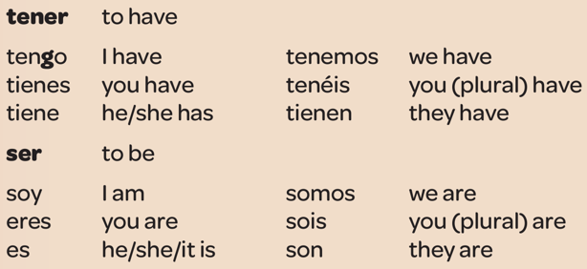
Year 7 - Knowledge Organiser 1 Modulo 1: Mi vida
THE INDEFINITE ARTICLE
In Spanish, the words for ‘a’ change according to whether the noun is masculine or feminine
REGULAR VERBS HABLAR AND VIVIR
Regular verbs follow a pattern.
THE DEFINITE ARTICLE
In Spanish, the word for ‘the’ changes according to the gender of the noun and whether it singular or plural
IRREGULAR VERBS
Some verbs are irregular. They don’t follow a pattern. Here there are two that you will meet a lot.
ADJECTIVES
Adjectives describe nouns. There are three main groups:
Ending in –o or – a
Ending in –e
Ending in a consonant
Their endings change to agree with the noun, like this:
MAKING VERBS NEGATIVES
To make a sentence or question negative, put no before the verb.
No tengo veinte años
Mi hermano no vive en Madrid

Slide 2
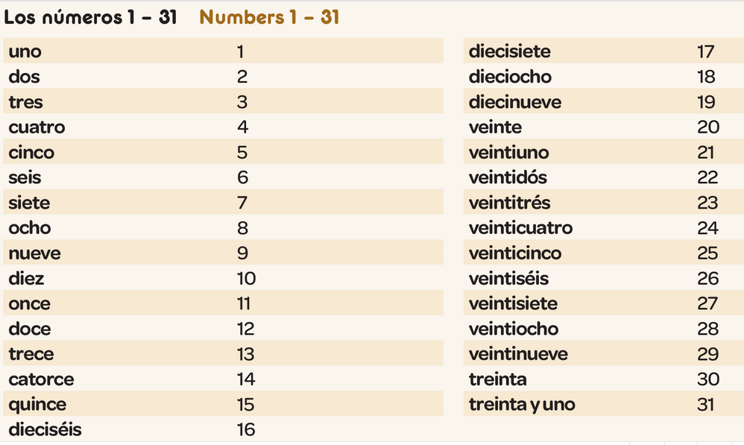
Year 7 - Knowledge Organiser 1 Modulo 1: Mi vida

