Slide 1
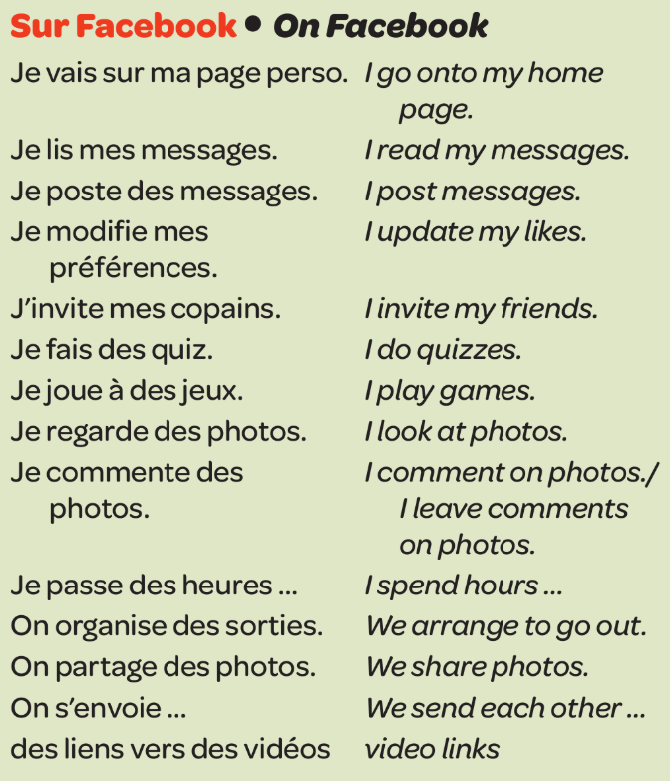
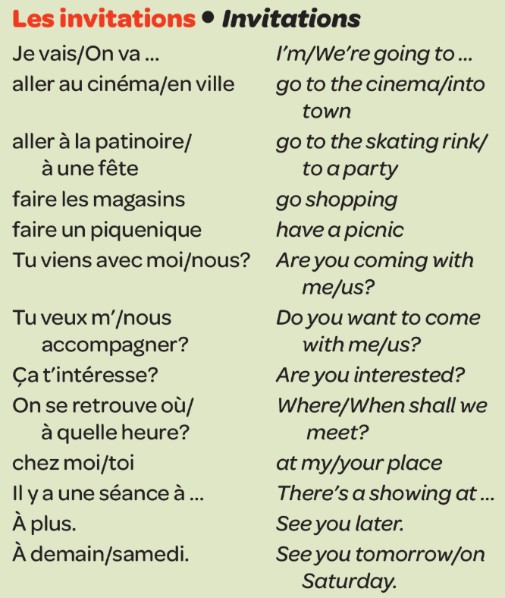
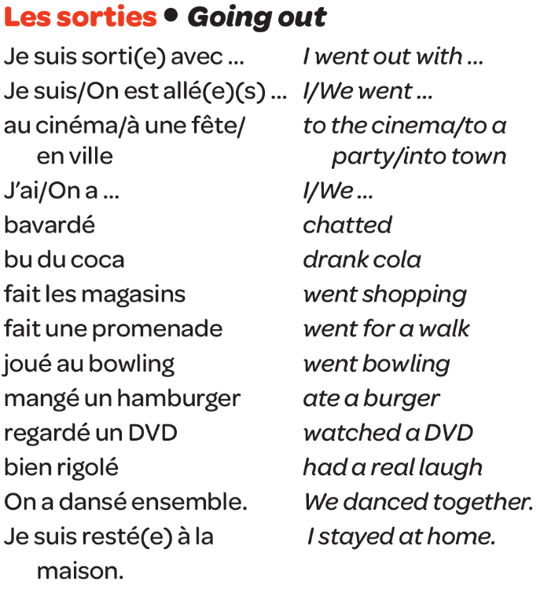
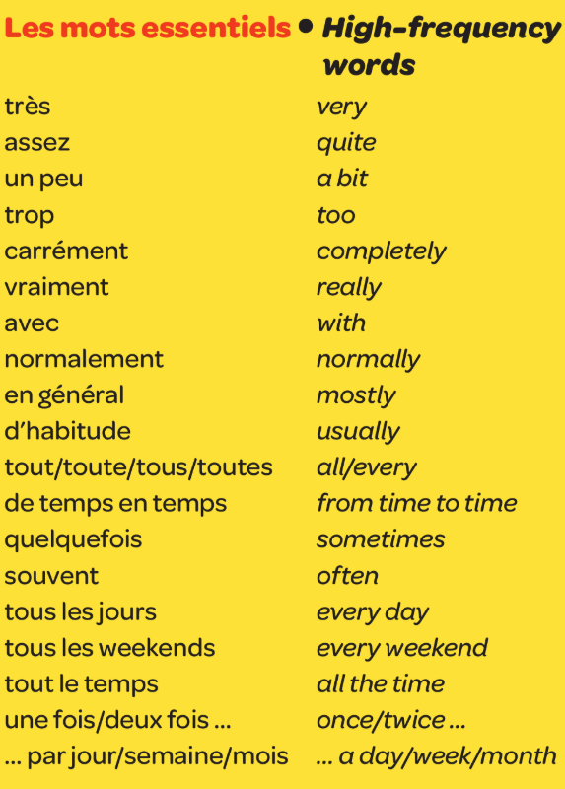
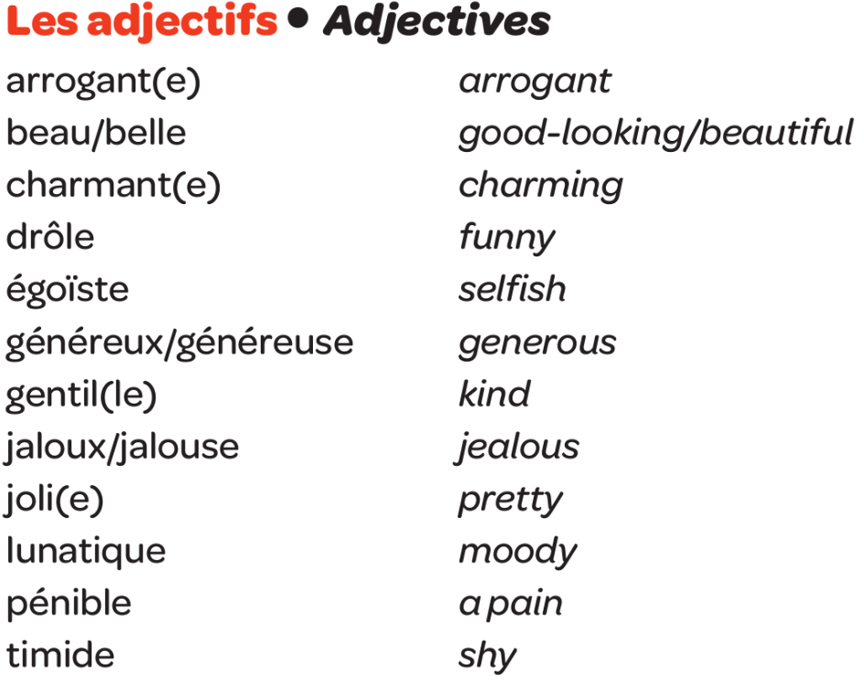
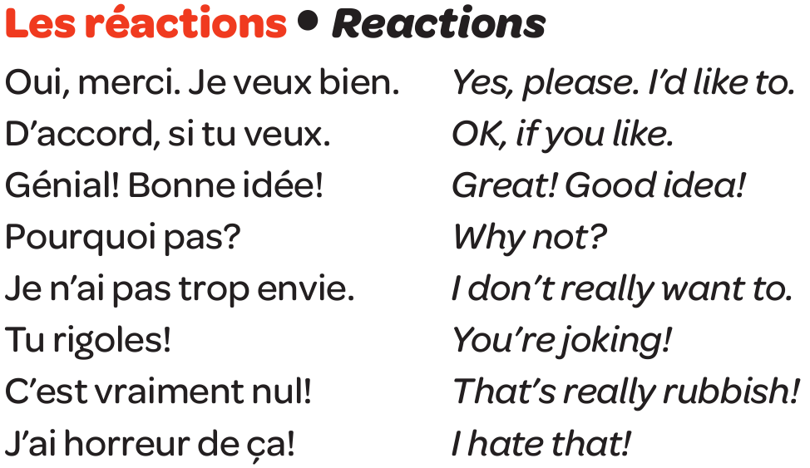
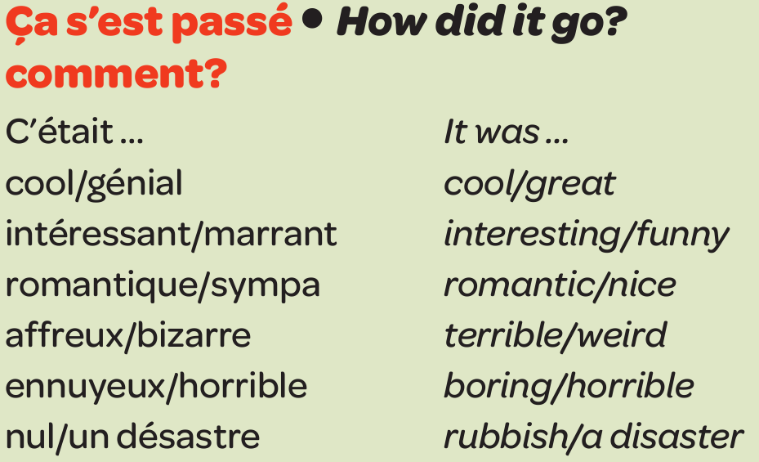
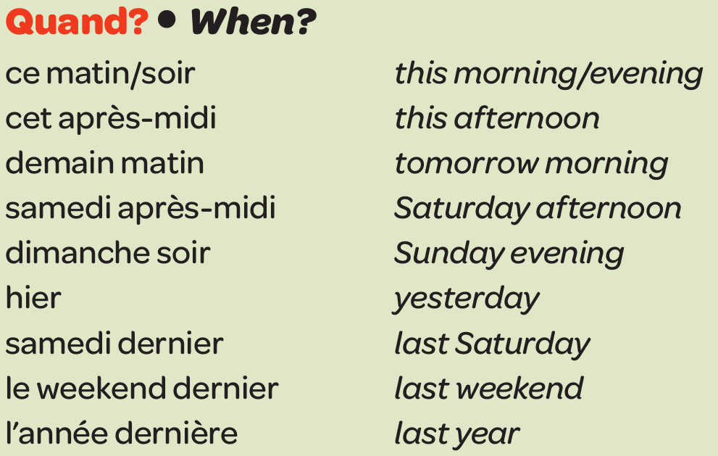
Year 9 French - Knowledge Organiser 1 Modulo 1: Planète Facebook

Slide 2
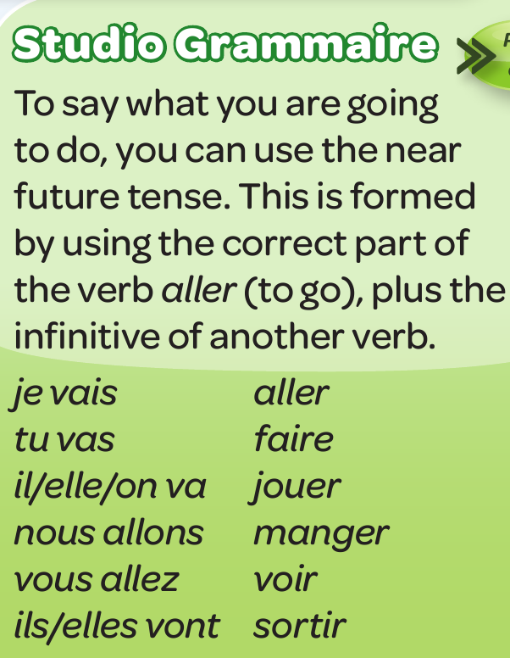
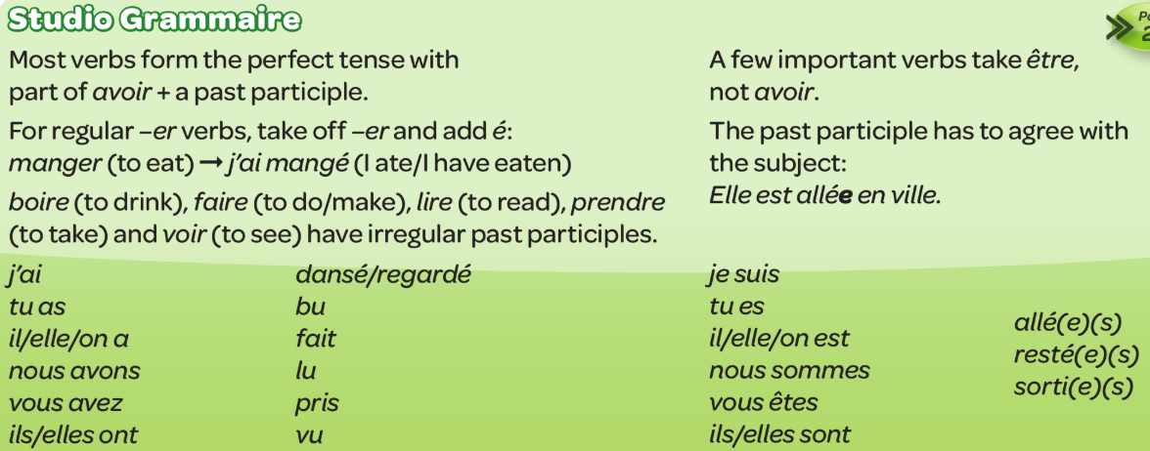
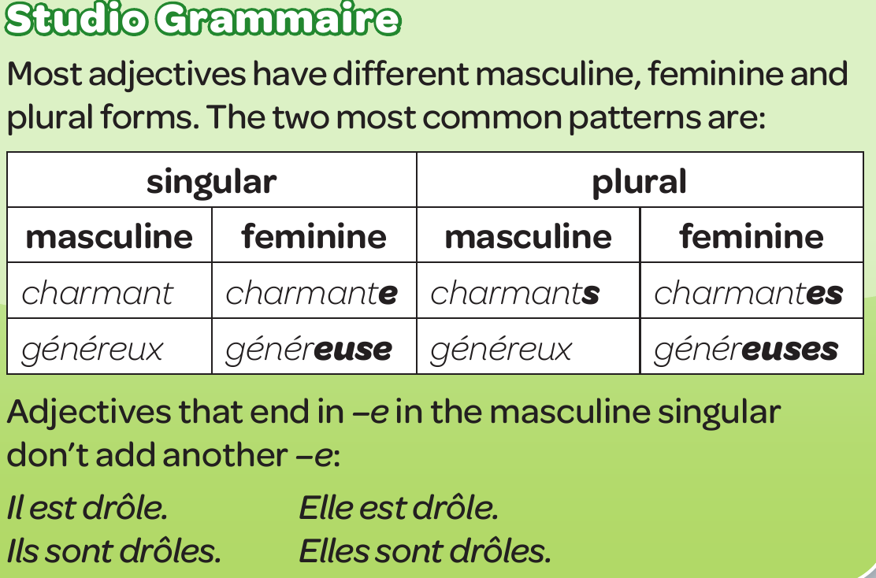
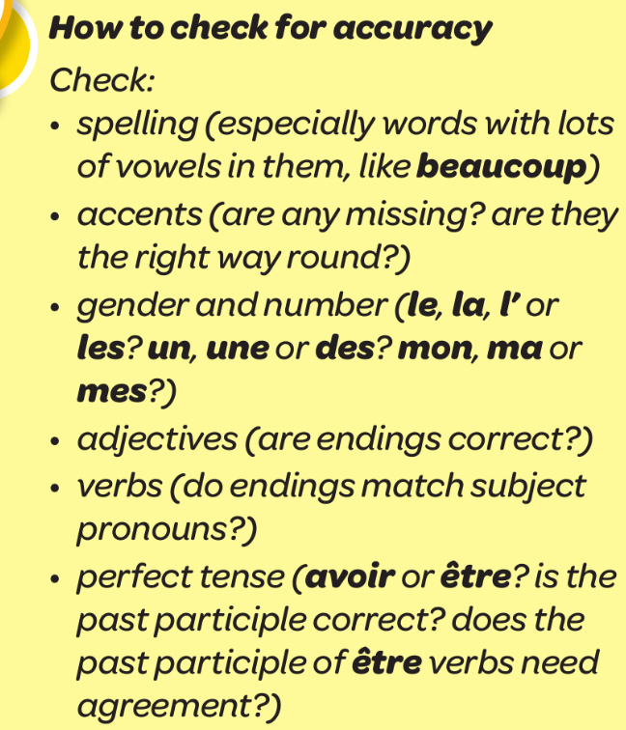
Year 9 French - Knowledge Organiser 1 Modulo 1: Planète Facebook
PRESENT TENSE – ER VERBS
NEAR FUTURE
PERFECT TENSE
DIRECT OBJECT PRONOUNS
FORMING THE PLURAL
CHECKING FOR ACCURACY
QUALIFIERS
THERE IS/ THERE ARE
TIME PHRASES

