Slide 1
Year 9 - Knowledge Organiser 1 Modulo 1: Somos así
The present tense of regular verbs:
There are three groups of regular verbs in Spanish –ar, -er, and –ir. Remember to replace the infinitive ending with this endings shown in bold, below.
The preterite of regular verbs: (Simple past tense)
You use the Preterite to talk about completed events in the past. For regular verbs, replace the infinitive ending with this endings in bold, below.
The present tense irregular verbs:
Some verbs are irregular. Learn these by heart.
The preterite of IR and SER:
Ir (to go) and Ser (to be) are irregular verbs. They are identical in the preterite.
The present tense of stem-changing verbs:
In the stem-changing verbs, the vowel in the stem changes in the ‘I’, ‘you’ (singular), ‘he/she’ and ‘they’ forms.
The Near Future tense:
You use the Near Future to say what you’re going to do. To form it, use the present tense or IR (to go) + a + Verb in the infinitive
Using different tenses:

Slide 2
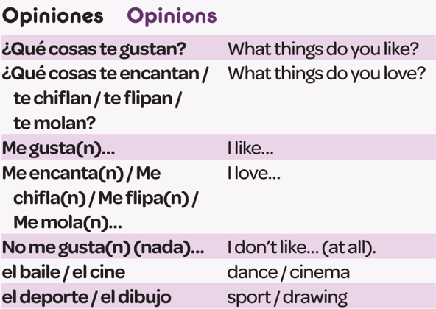
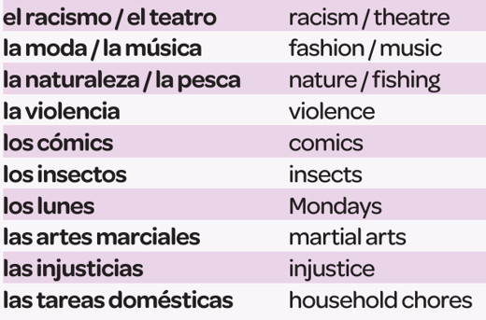
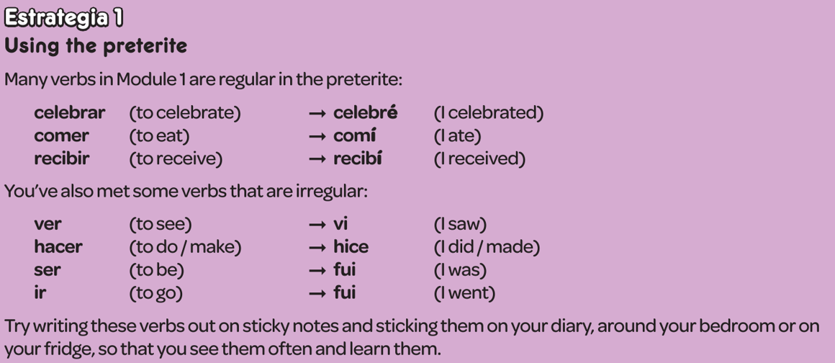
Year 9 - Knowledge Organiser 1 Modulo 1: Somos así

