Slide 1
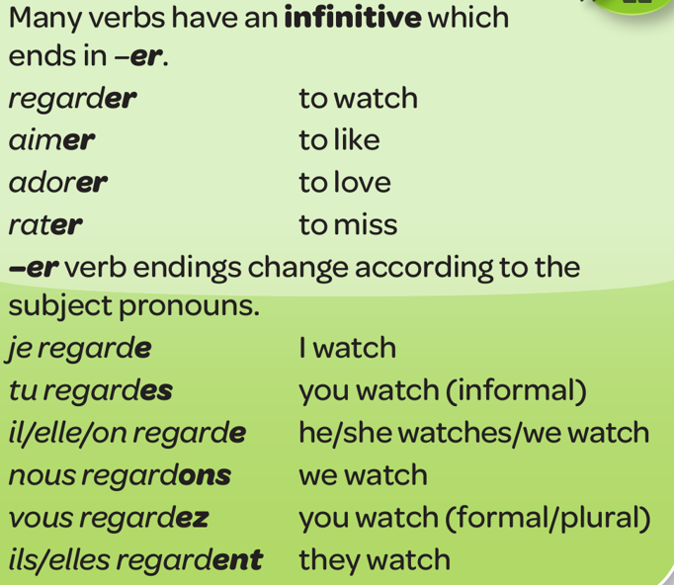
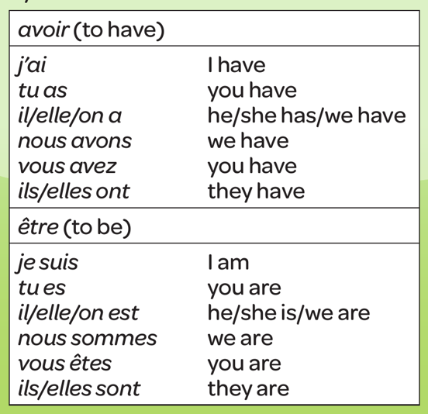
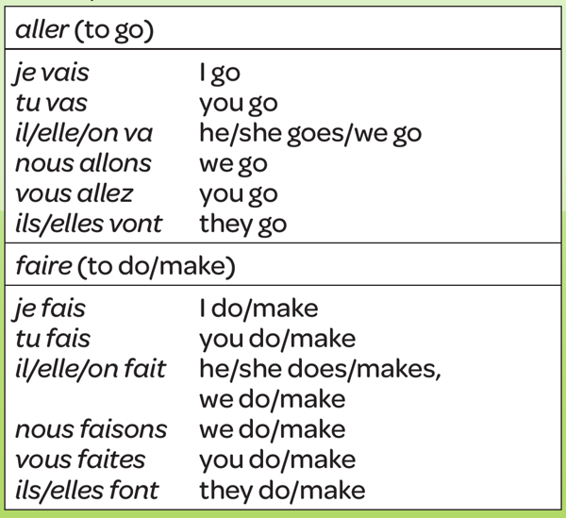
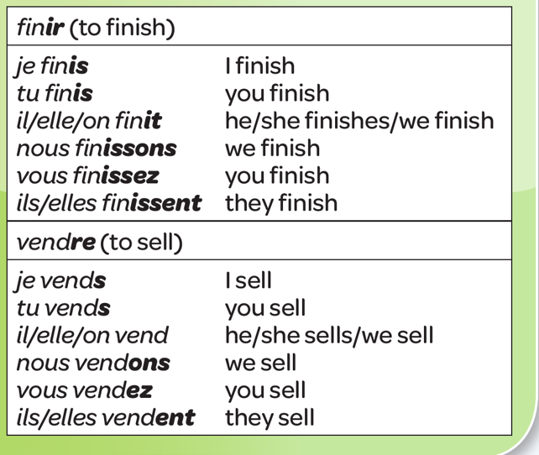
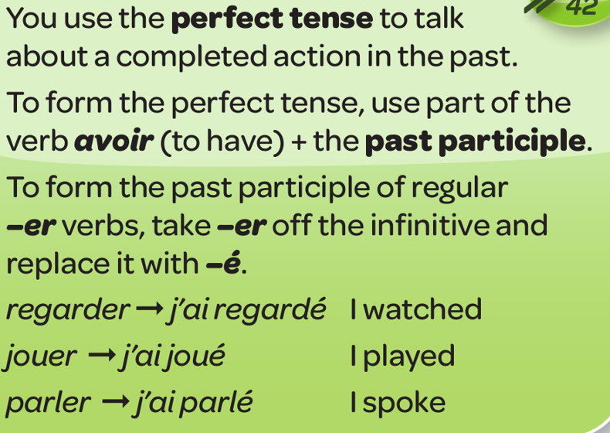
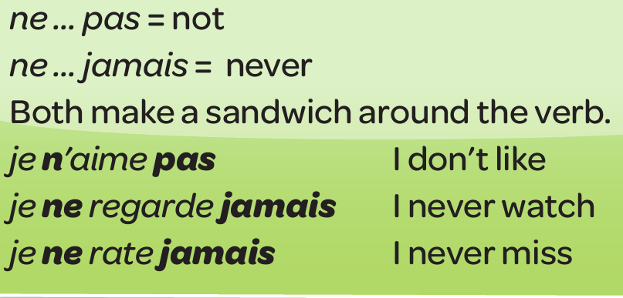
Year 8 - Knowledge Organiser 1 Module 1: T’es branché(e)?
REGULAR –ER VERBS IN THE PRESENT
COMMON IRREGULAR VERBS
Some verbs are irregular. They don’t follow a pattern. Here there are four that you will meet a lot.
REGULAR –IR AND –RE VERBS IN THE PRESENT
Use connectives and
intensifiers to make
your language more
interesting:
INTENSIFIERS –
Assez (quite)
Très (very)
CONNECTIVES:
Et (and)
Aussi (also)
Mais (but)
Ou (or)
Comme (like, as)
Parce que (because)
Car (because)
THE PERFECT TENSE
MAKING VERBS NEGATIVE

Slide 2
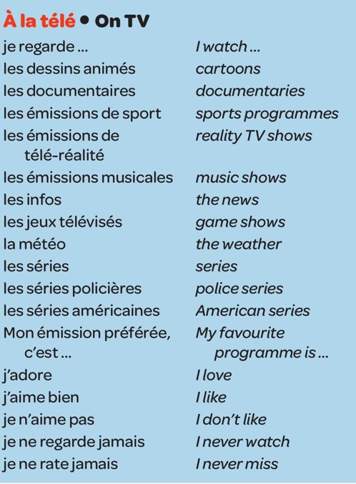
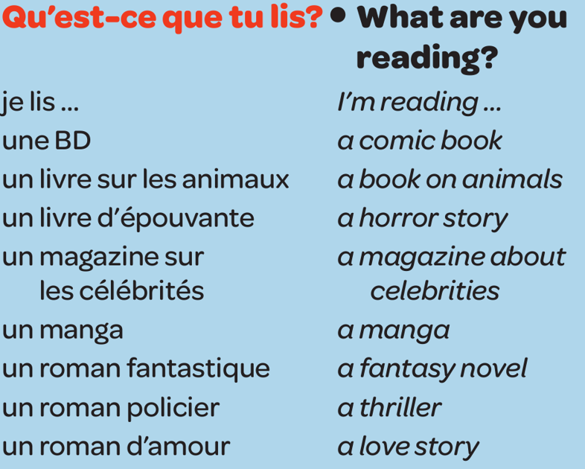
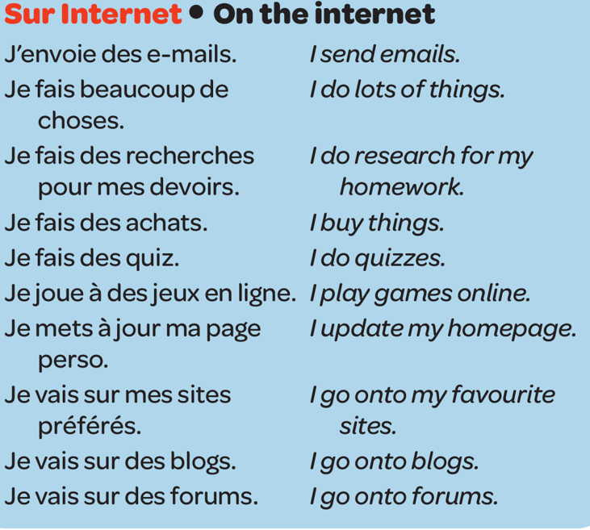
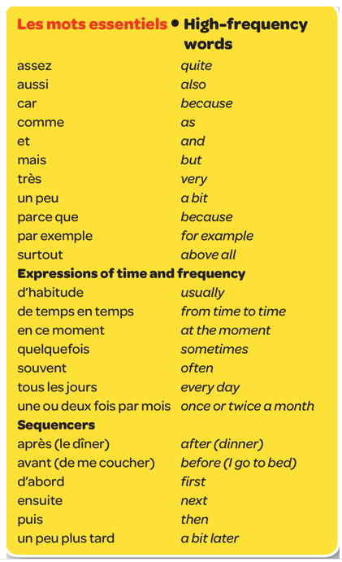
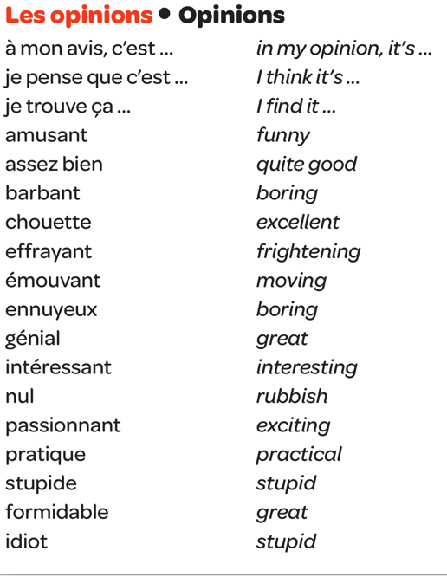
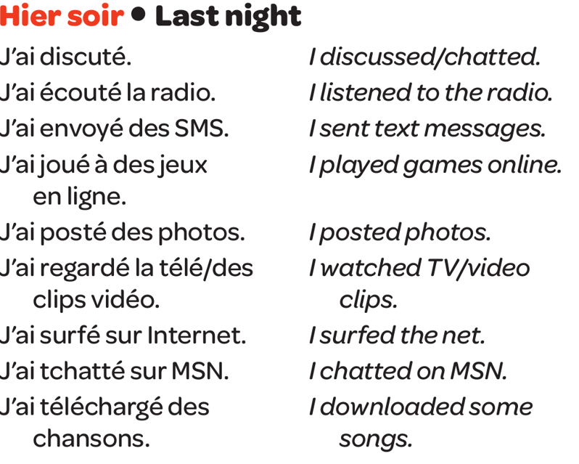
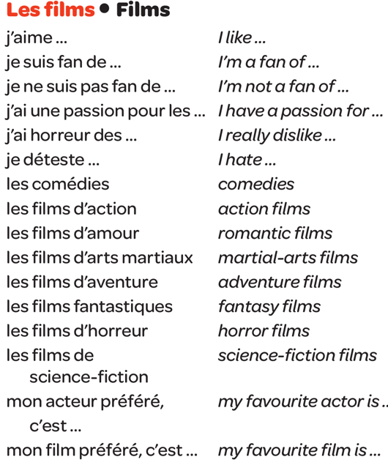
Year 8 - Knowledge Organiser 1 Module 1: T’es branché(e)?

