Slide 1
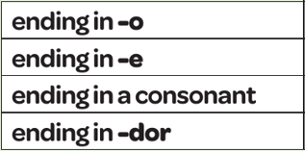
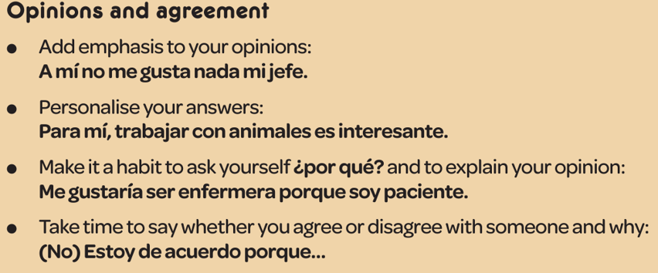
Year 9 - Knowledge Organiser 2 Modulo 2: ¡Orientate!
COMPLEX STRUCTURE; TENER QUE + INFINITIVE
To say what you have to do, you use tener que + infinitive
USING DIFFERENT TIME FRAMES
To reach a higher level, you need to show that you can use verbs in the present, the preterite and the near future tense. Remember that regular and irregular verbs take different endings in each tense and stem-changing verbs may also change their spelling in the stem or main part of the verb .
ADJECTIVE AGREEMENT
Adjectives describe nouns. Their endings change to agree with the noun they describe both in gender and in number.
THE NEAR FUTURE TENSE
You use the Near Future to say what you’re going to do. To form it, use the present tense or IR (to go) + a + Verb in the infinitive
Examples:
Voy a ganar dinero – I am going to earn money
Vamos a viajar mucho – we are going to travel a lot

Slide 2
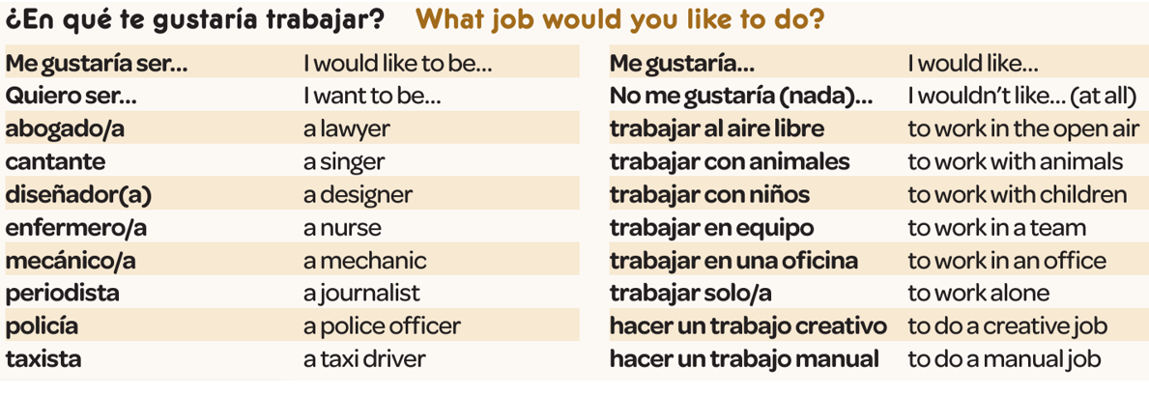
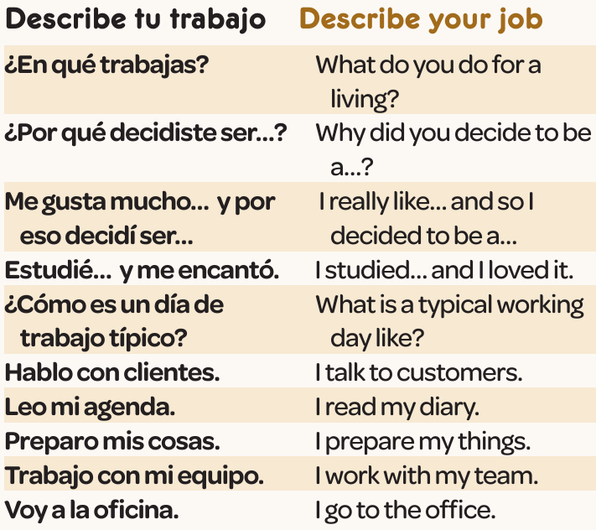
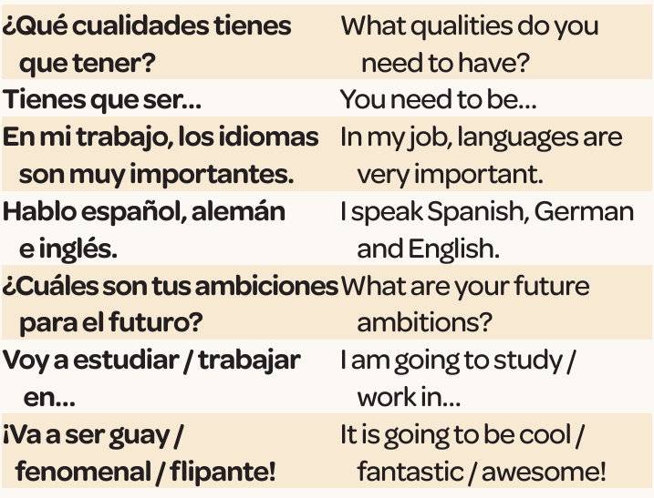
Year 9 - Knowledge Organiser 2 Modulo 2: ¡Orientate!

