Slide 1
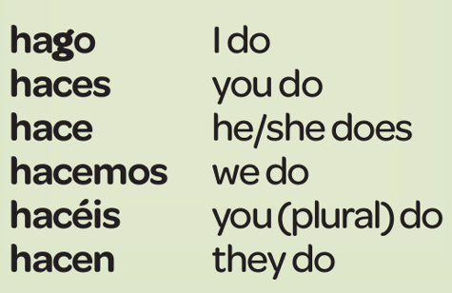
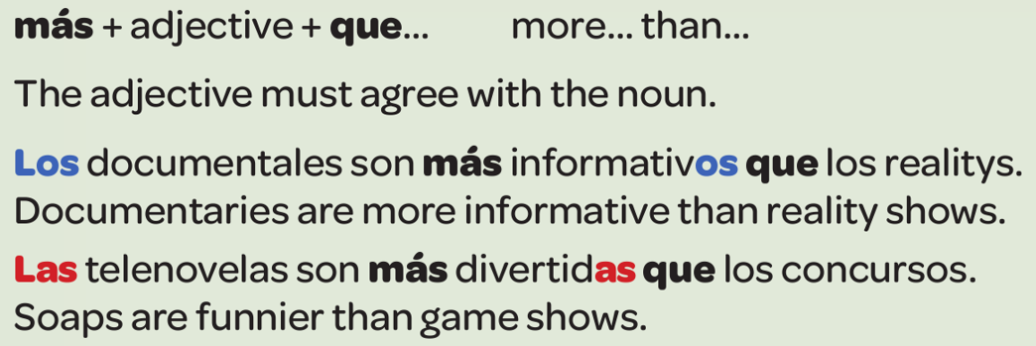
Year 8 - Knowledge Organiser 2 Modulo 2: Todo sobre mi vida
THE PRESENT TENSE OF REGULAR VERBS
You use the Present Tense to talk about what usually happens. Regular –ar, -er and –ir verbs follow these patterns
IRREGULAR VERBS
HACER (to do) is an important irregular verb. The c changes to g in the ‘I’ form. Learn it by heart.
GIVING OPINIONS
When you give opinion with me gusta, make sure you use el, la, los, las before the noun (You may not use ‘the’ in English, but you MUST use el, la, los or las in Spanish.
Me gusta el rap – I like rap
Le encanta la música pop – he/she likes pop music
However, you don’t need el or la if you’re saying what style of music you listen to
Escucho rap – I listen to rap
USING THE COMPARATIVE
When you want to compare two things, you use the comparative.
USING THE PRESENT TENSE AND THE PRETERITE TOGETHER

Slide 2
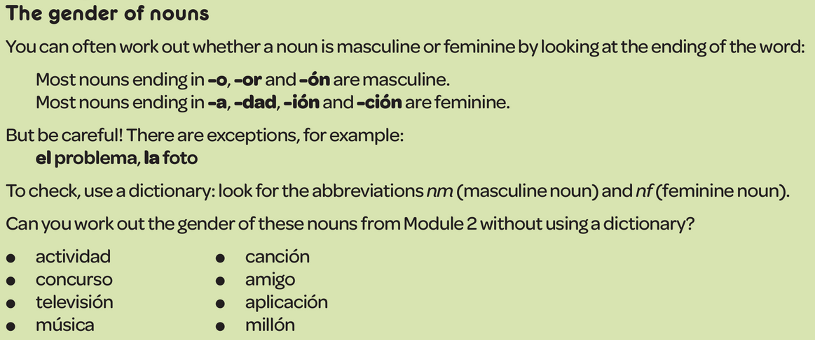
Year 8 - Knowledge Organiser 2 Modulo 2: Todo sobre mi vida

