Slide 1
Year 8 - Knowledge Organiser 3 Modulo 3: ¡A comer!
NEGATIVES
USING THREE TENSES TOGETHER
TU, USTED, USTEDES
THE NEAR FUTURE TENSE
You use the Near Future to say what you’re going to do. To form it, use the present tense or IR (to go) + a + Verb in the infinitive
Use time expressions for context:

Slide 2
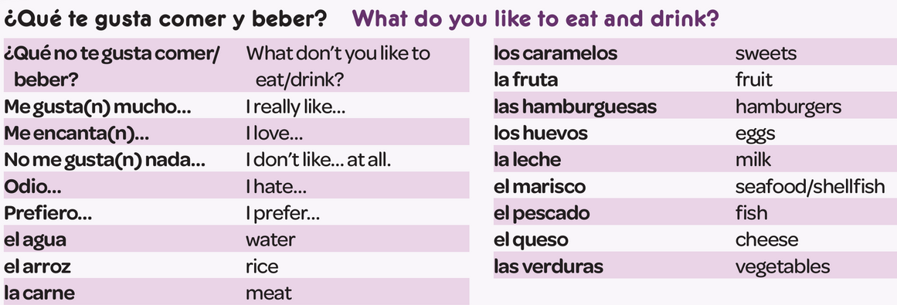
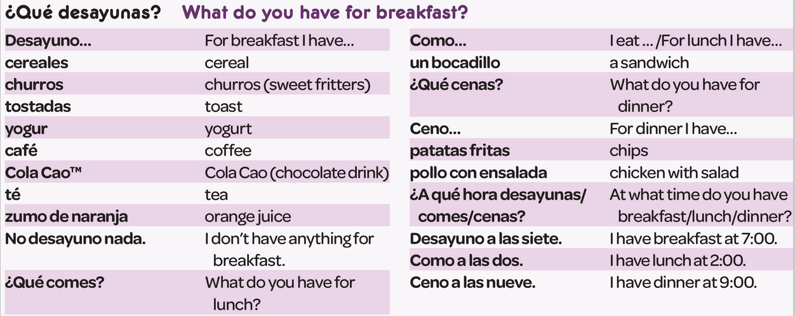
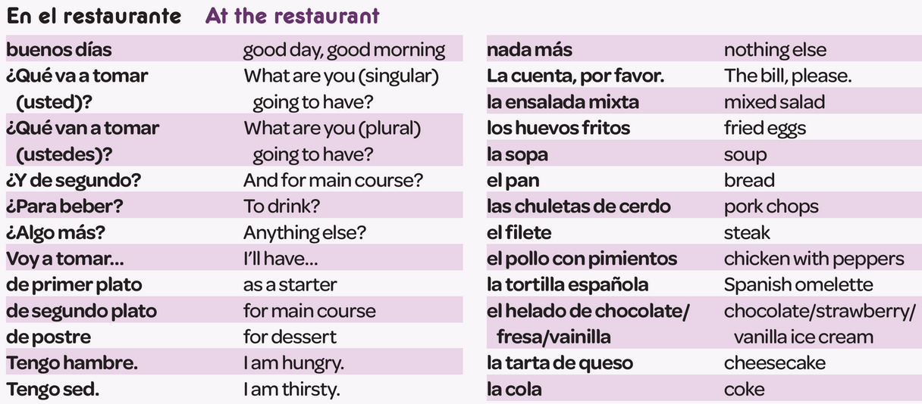
Year 8 - Knowledge Organiser 3 Modulo 3: ¡A comer!

