Slide 1
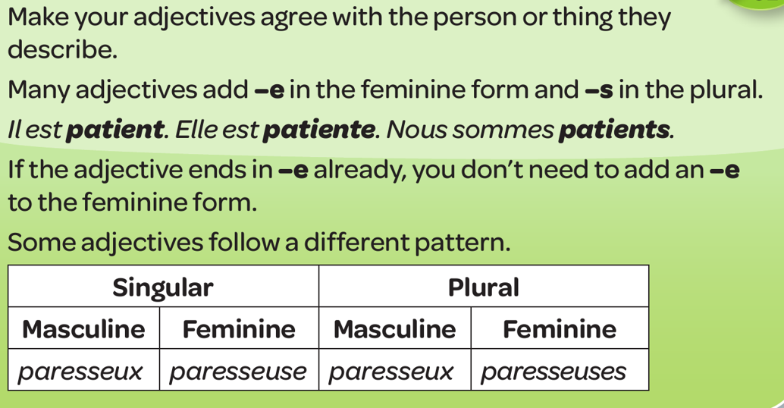
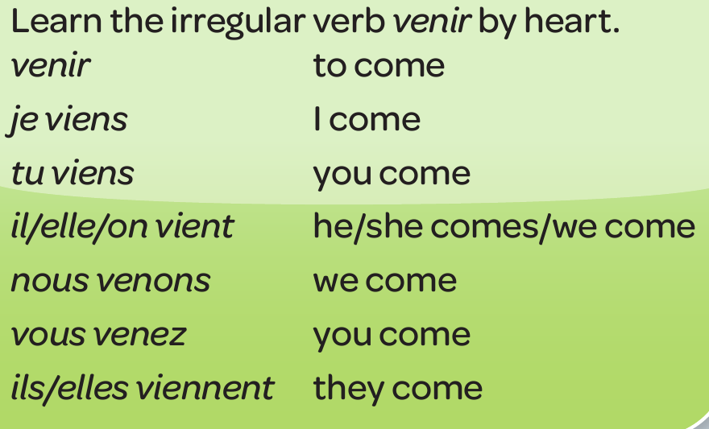
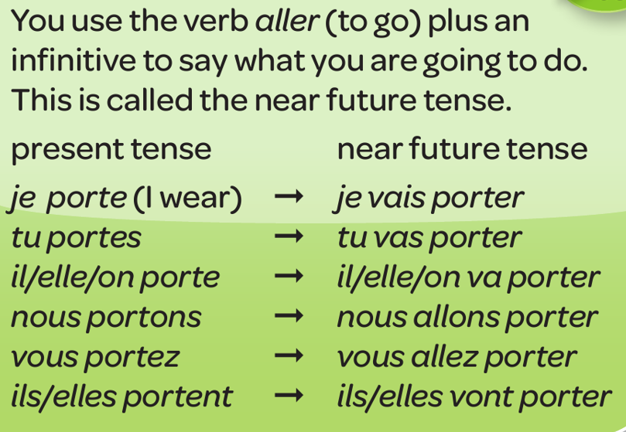
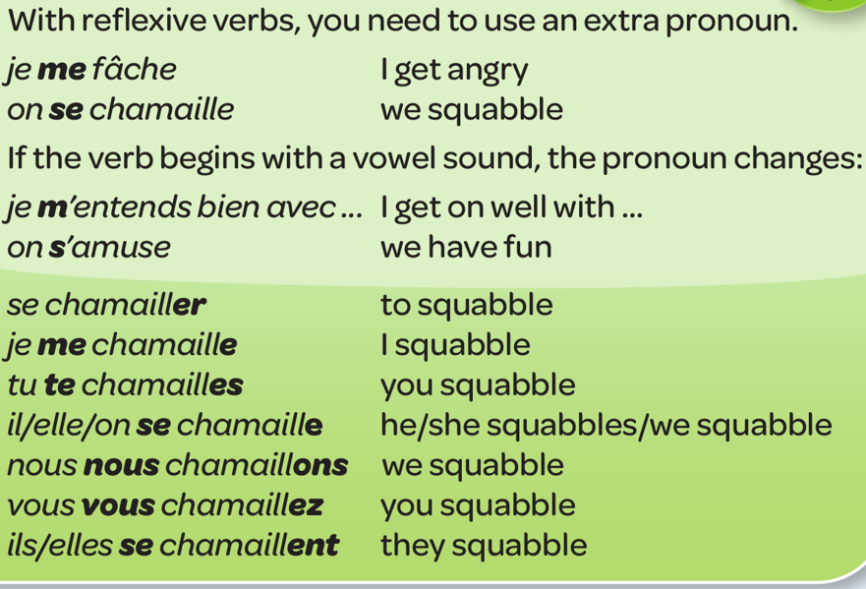
Year 8 - Knowledge Organiser 3 Module 3: Mon identité
ADJECTIVAL AGREEMENT
COMMON IRREGULAR VERBS - VENIR
‘Venir’ is irregular and doesn’t follow a pattern.
THE NEAR FUTURE (going to)
REFLEXIVE VERBS
THE 3 TENSES – use these verbs and expressions to refer to the present, past and future
Past | Present | Future
Hier (yesterday) | Normalement (normally) | Ce weekend,…(this weekend)
La semaine dernière (last week) | D’habitude (usually) | Cet été (this summer)
J’ai regardé (I saw) | je regarde (I see) | je vais regarder (I’m going to see)
Je suis allé(e) (I went) | je vais (I go) | je vais aller (I’m going to go)
C’était (it was) | C’est (it is) | Ça va être (it’s going to be)

Slide 2
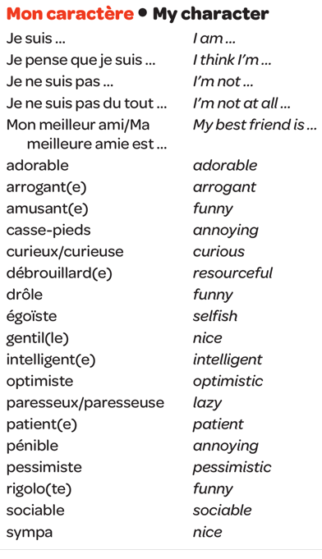
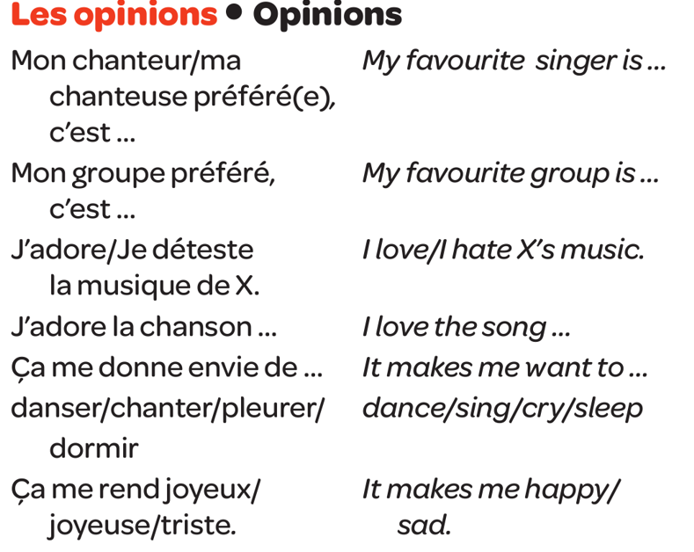
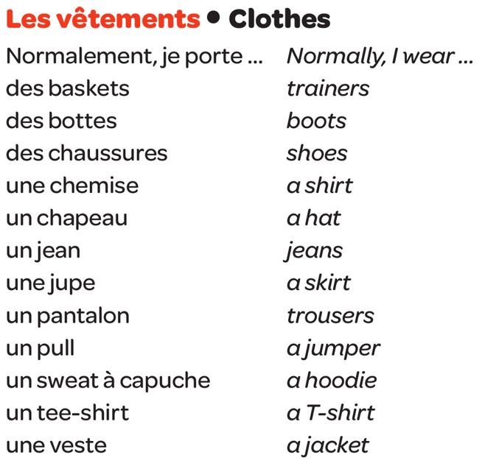
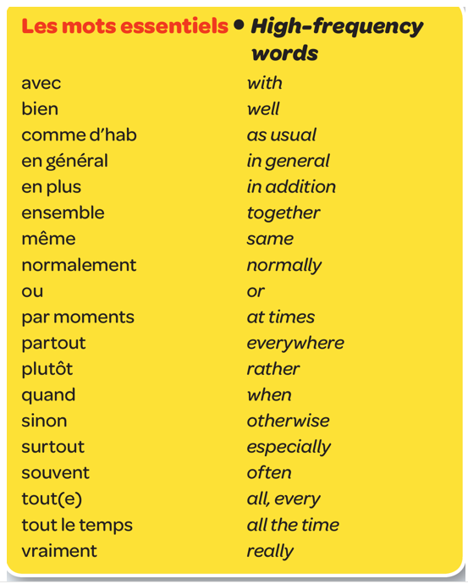
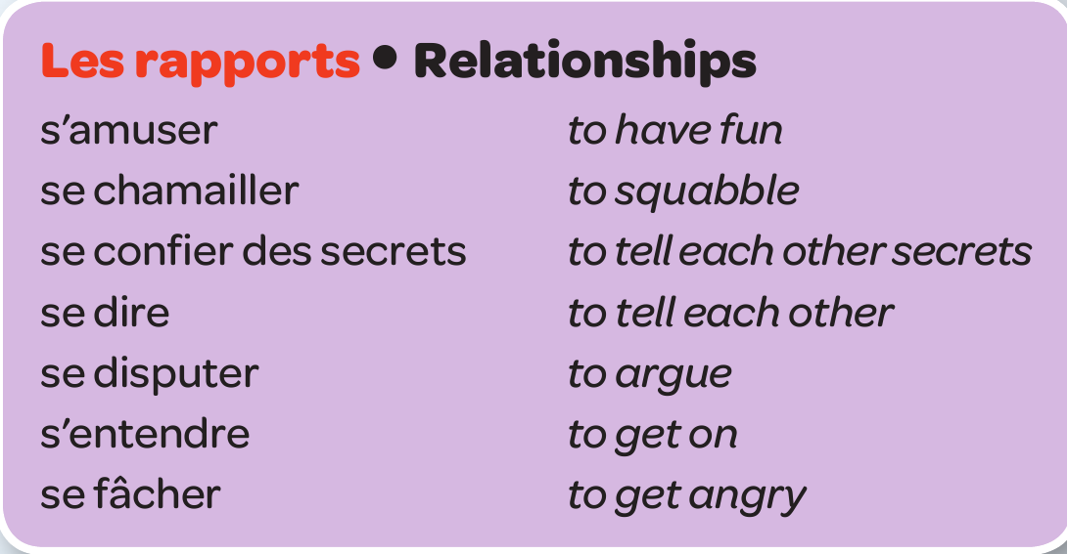
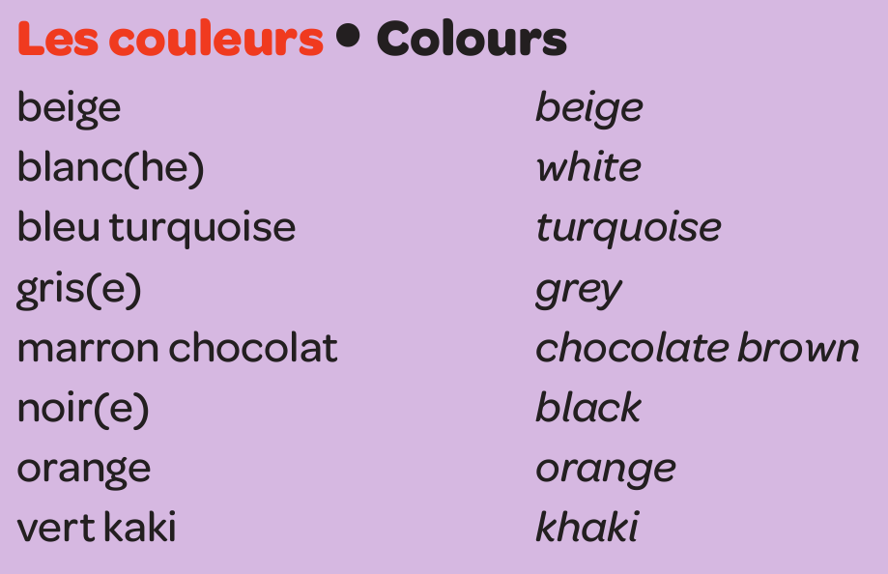
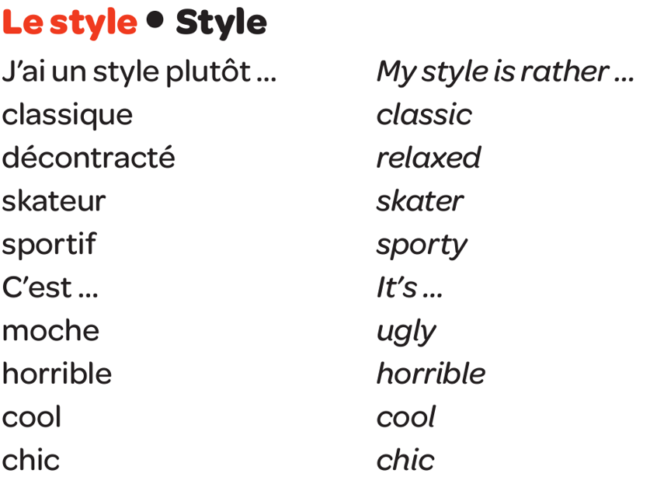
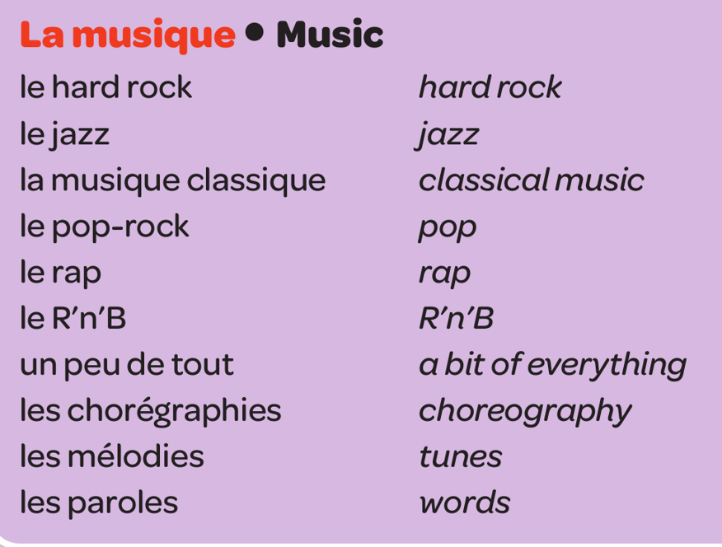
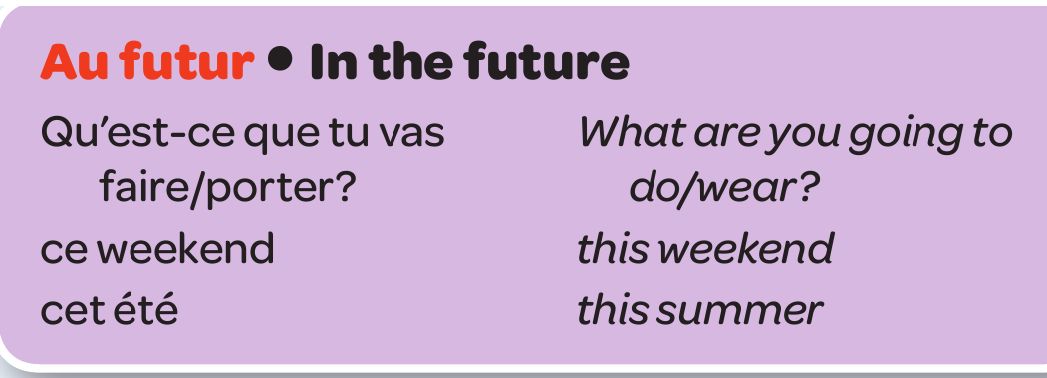
Year 8 - Knowledge Organiser 3 Module 3: Mon identité

