Slide 1
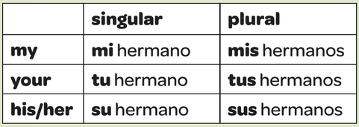
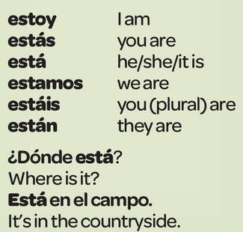
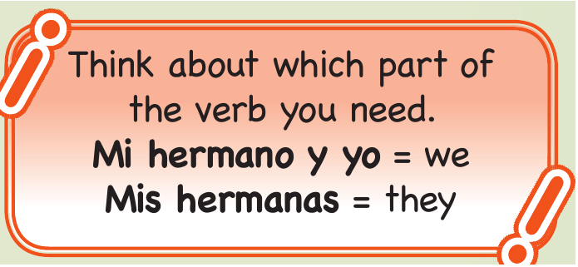
Year 7 - Knowledge Organiser 4 Modulo 4: Mi familia y mis amigos
PRESENT TENSE IRREGULAR VERBS TENER AND SER
Tener and Ser are very useful irregular verbs. Use them to talk about your self and other people.
POSSESSIVE ADJECTIVES
Possessive adjectives are the words for ‘my’, ‘your’, ‘his’, ‘her’, etc.
This words agree in number with the noun they are describing.
PRESENT TENSE IRREGULAR VERB ESTAR
Use the verb estar (to be) when you are talking about location (where something is).
ADJECTIVES:
Adjectives describe nouns. Their endings change to agree with the noun they describe. Adjective fall into three groups. The ending for each group work like this:
NOTE: In Spanish there are two verbs meaning ‘to be’: SER and ESTAR.
Use SER to describe charasteristics of people, houses, etc.
Soy alta (I am tall). Mi casa es moderna (My house is modern)
Use ESTAR for location
Tengo el pelo rubio, corto y liso – I have short, straight and blond hair
NOTE: In Spanish most adjectives come after the word they are describing:
Tengo el pelo rubio, corto y liso – I have short, straight and blond hair

Slide 2
Year 7 - Knowledge Organiser 4 Modulo 4: Mi familia y mis amigos

