Slide 1
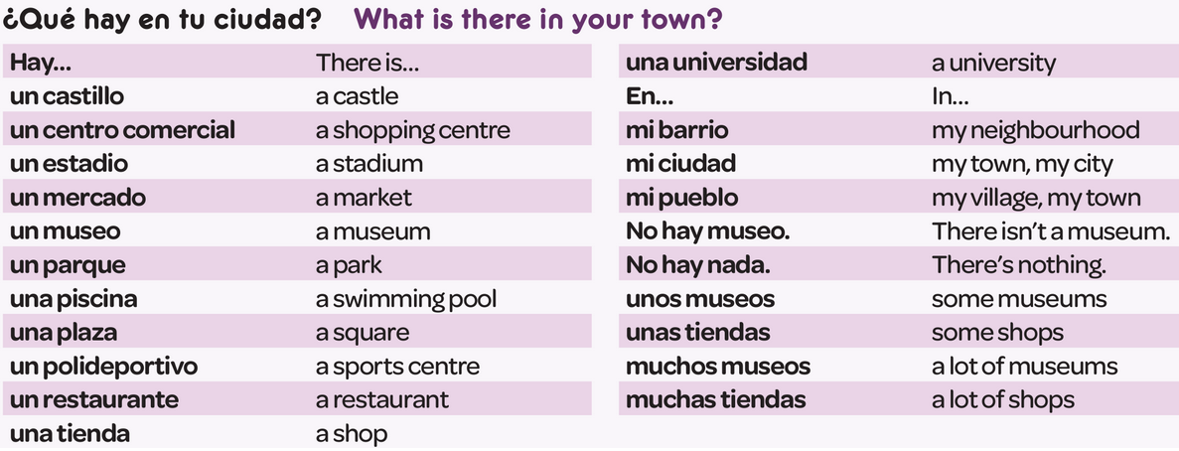
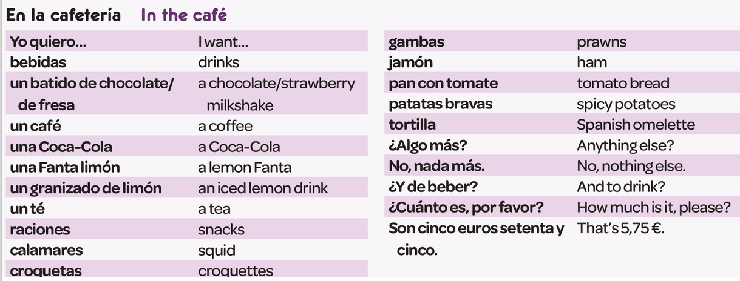
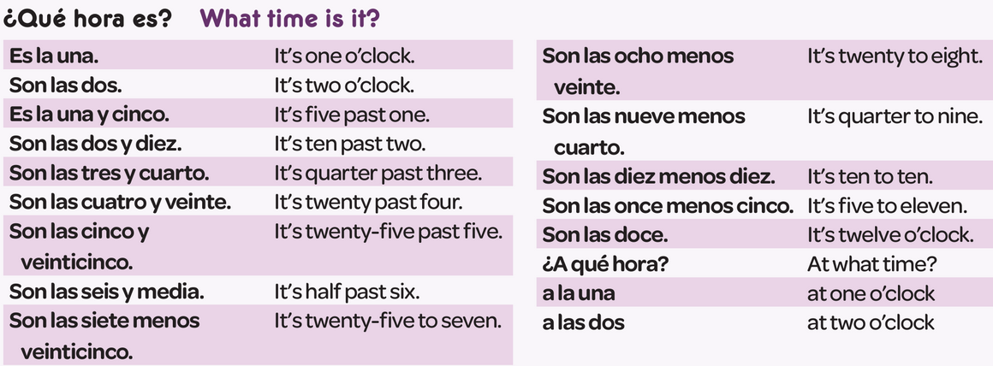
Year 7 - Knowledge Organiser 5 Modulo 5: Mi Ciudad

Slide 2
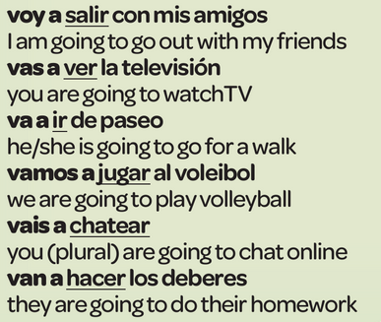
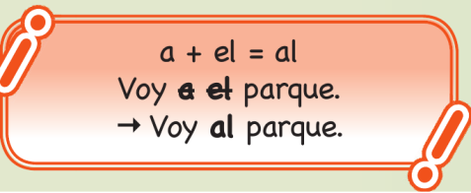
Year 7 - Knowledge Organiser 5 Modulo 5: Mi Ciudad
‘A’, ‘SOME’, ‘MANY’
The words for ‘a’, ‘some’ and ‘many’ change according to the gender of the noun and whether it is singular or plural.
THE NEAR FUTURE TENSE:
You use the Near Future to say what you’re going to do. To form it, use the present tense or IR (to go) + a + Verb in the infinitive
PRESENT TENSE IRREGUULAR VERB IR
IR (to go) is a key irregular verb
USING TWO TENSES TOGETHER:
To reach a higher level, you need to show that you can use two tenses, for example present tense and near future tense.
Normalmente, el fin de semana mis amigos y yo vamos al parque y jugamos al fútbol. Sin embargo, el próximo domingo vamos a ir al centro comercial y vamos a comer en un restaurante.
STEM-CHANGING VERB QUERER:
QUERER (to want) is a stem-changing verb. It has regular endings, but some parts of the verb change the vowel in the ‘stem’. Some people call these ‘boots’ verbs.

