Slide 1
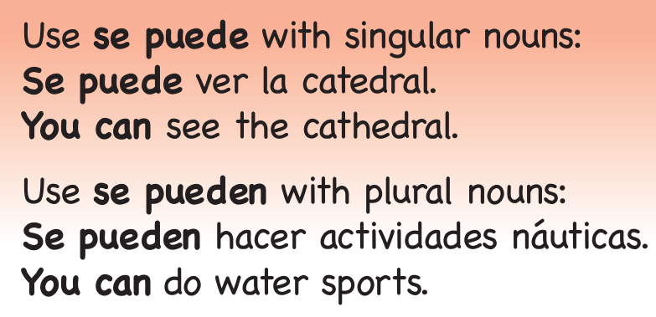
Year 8 - Knowledge Organiser 5 Modulo 5: Operación verano
THE COMPARATIVE
USING MORE COMPLEX STRUCTURES: SE PUEDE / SE PUEDEN
Se puede and Se pueden mean ‘you can’. They are usually followed by an infinitive.
THE SUPERLATIVE
USING DIFFERENT TIME FRAMES
To reach a higher level, you need to show that you can use verbs in the present, the preterite and the near future tense. To do this, you need to be able to form the verbs correctly. Different verb groups work like this in the three main tenses
THE IMPERATIVE (tú form)

Slide 2
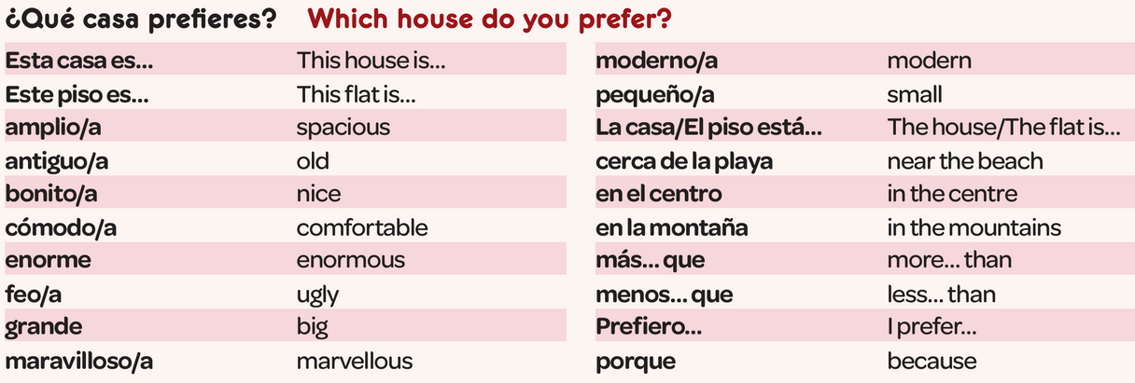
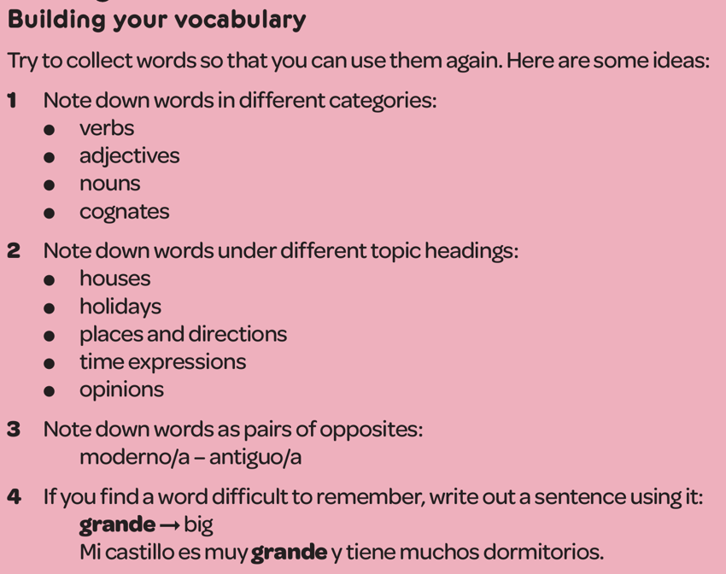
Year 8 - Knowledge Organiser 5 Modulo 5: Operación verano

