Slide 1
Year 7 - Knowledge Organiser 2 Module 2: Mon collège
ASKING QUESTIONS IN FRENCH
To ask a question you can:
Either
Turn a statement into a question by making your voice go up at the end of the sentence.
Example: Tu aimes le français? – Do you like French?
Or
Use Est-ce que…? And make your voice go up at the end.
Example: Est-ce que tu aimes le français? – Do you like French?
USING ‘ON’
There are two words in French for ‘we’. These are ‘on’ and ‘nous’.
The most commonly used is ‘on’.
‘On’ can also mean ‘you’. ‘they’ and ‘people (in general)’.
‘On’ has the same verb form as il/elle.
Example:
On bavarde et on rigole = We chat and we have a laugh.
On mange à la cantine = We eat in the canteen.
EXPRESSING OPINIONS/LIKES AND DISLIKES
When you want to say what you like or dislike you must use the definite article before the noun.
Example:
J’aime le théâtre et la musique= I like drama and music.
Je déteste les maths et les sciences – I hate maths and science.
THE PARTITIVE ARTICLE
The partitive article means ‘some’. It has a different form with masculine, feminine and plural nouns. De l’ is used before a vowel sound or a silent ‘h’.
Example:
Le poulet (chicken) du poulet = some chicken
La glace (ice-cream)de la glace = some ice-cream
L’eau- (water) de l’eau = some water
Les frites (chips) des frites = some chips
You often have to use the partitive article in French where you could miss it out in English.
Example:
Pour le déjeuner, je mange du poulet avec des frites= For lunch I eat (some)chicken and (some) chips.
ACCENTS IN FRENCH
There are four different accents in French.
é = acute accent
è = grave accent
â = circumflex
ç = cedilla
Accents are important in French. Don’t forget accents when you are writing!

Slide 2
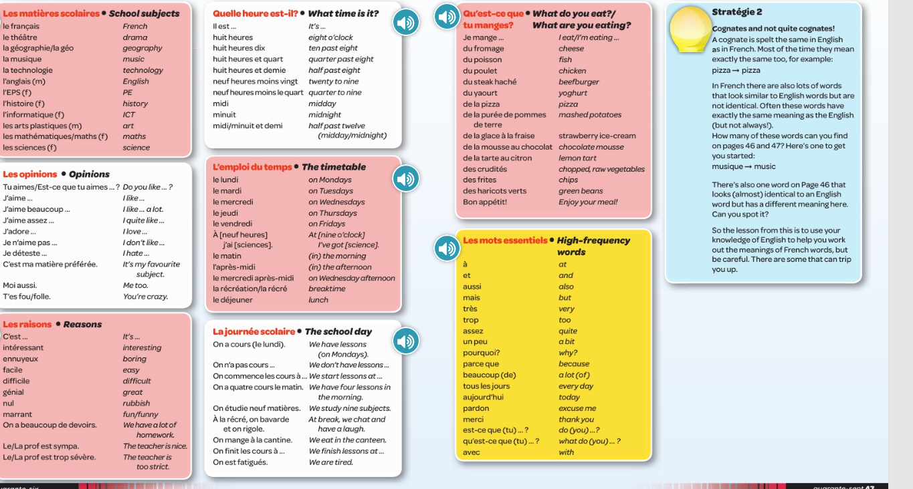
Year 7 - Knowledge Organiser 2 Module 2: Mon collège

