Slide 1
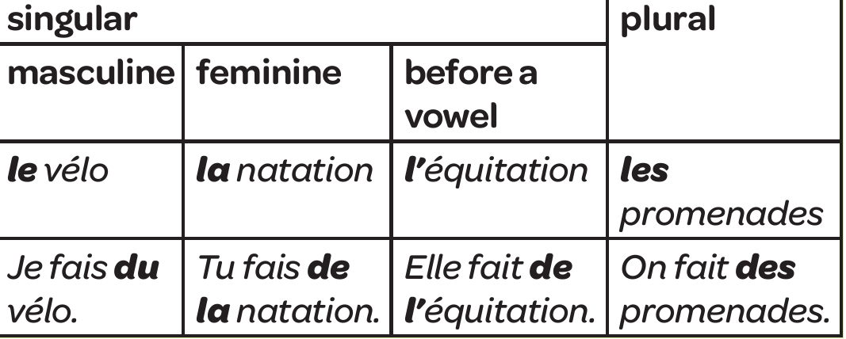
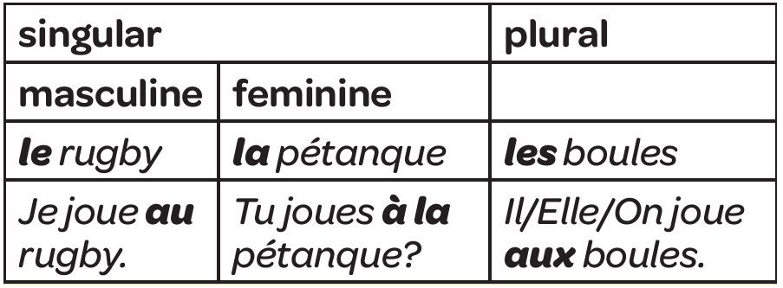
Year 7 - Knowledge Organiser 3 Module 3: Mes Passetemps
REGULAR VERBS – THE PRESENT TENSE
You use the present tense in French to say what you do or what you are doing.
Most verbs in French are regular – er verbs(eg surfer – to surf, jouer to play, regarder to watch). The endings of regular –er verbs all follow the same pattern.
Example: Regarder to watch
Je regarde– I watch (am watching)
Tu regardes – You watch (singular/informal)
Il/elle/on regarde – he /she watches/we watch
Nous regardons – we watch
Vous regardez = You watch (plural and informal)
Ils/ells regardent – they watch.
Note – The verb envoyer – to send has a slight irregularity in the first three persons. J’envoie – I send
Tu envoies – you send
Il/elle /on envoie – he/she sends/ we send.
FAIRE DE
You use faire de to talk about some sports and other activities. ‘De’ has a different form with masculine, feminine and plural nouns. Please see table below:
JOUER A
You use jouer a to talk about playing a sport or a game. ‘a’ has a different form with masculine, feminine and plural nouns (see right). Most sports are masculine singular. Please see table below:
IRREGULAR VERBS – THE PRESENT TENSE
FAIRE (to do or make) is an important irregular verb.
It does not follow a set pattern.
Je fais – I do/make
Tu fais – You do/make
Il/elle/on fait – He/she does/makes/ we do/make
Nous faisons – We do/make
Vous faites –You do/make (plural/formal)
Ils/elles font – they do/make.

Slide 2
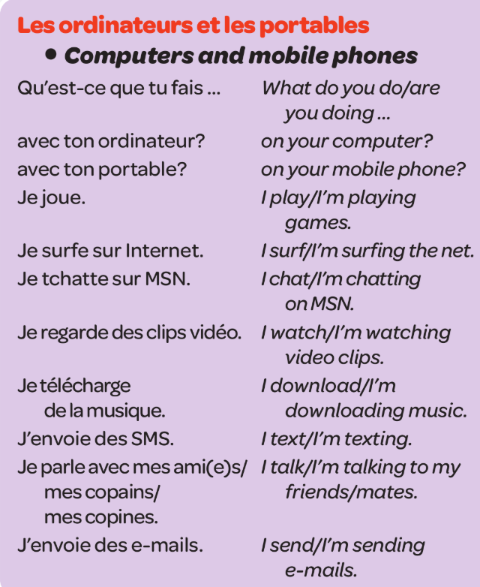
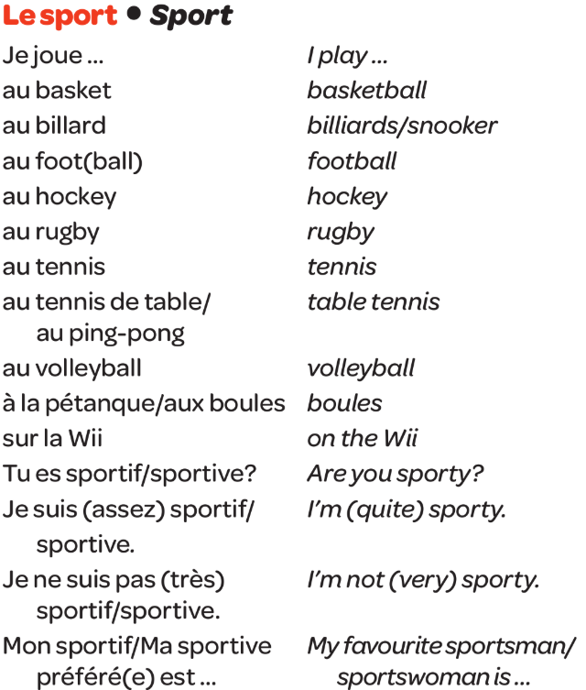
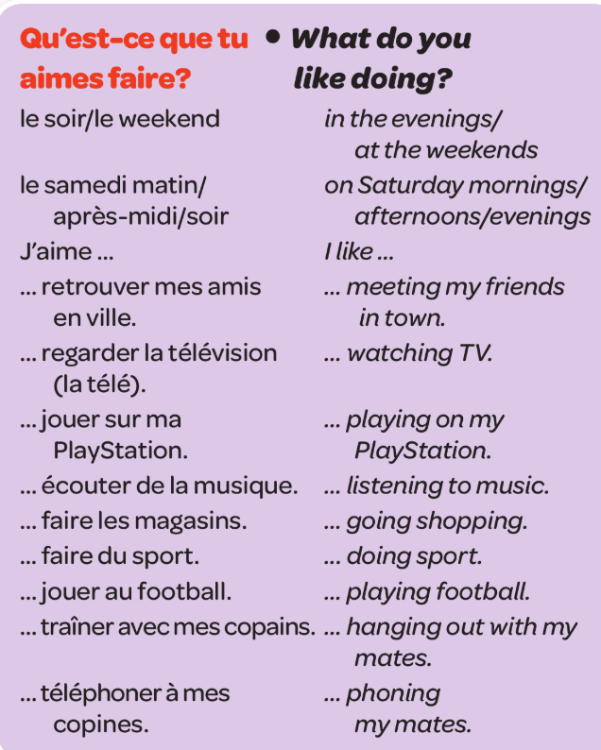
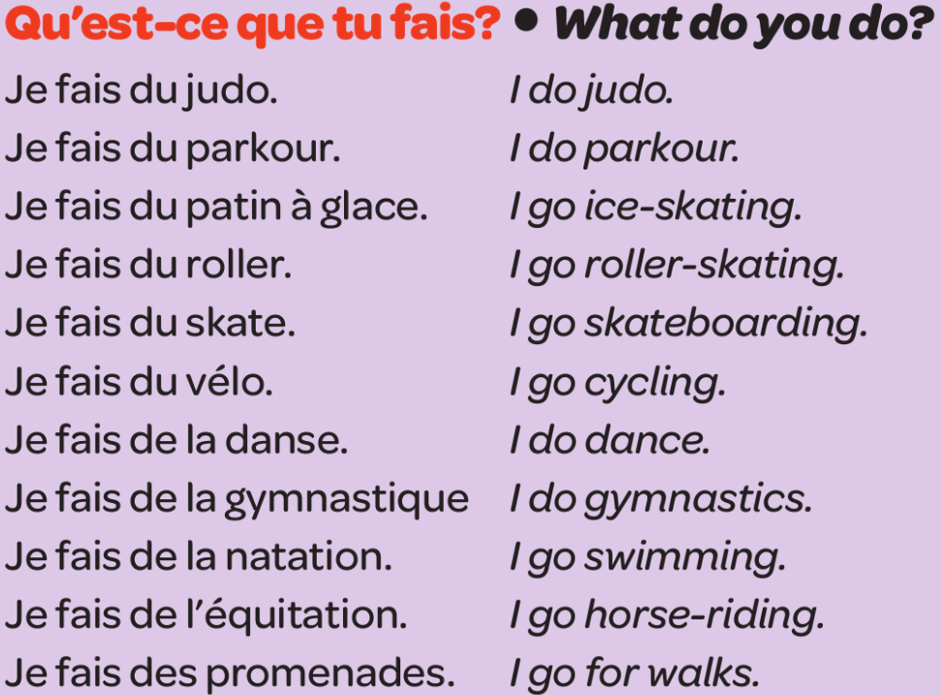
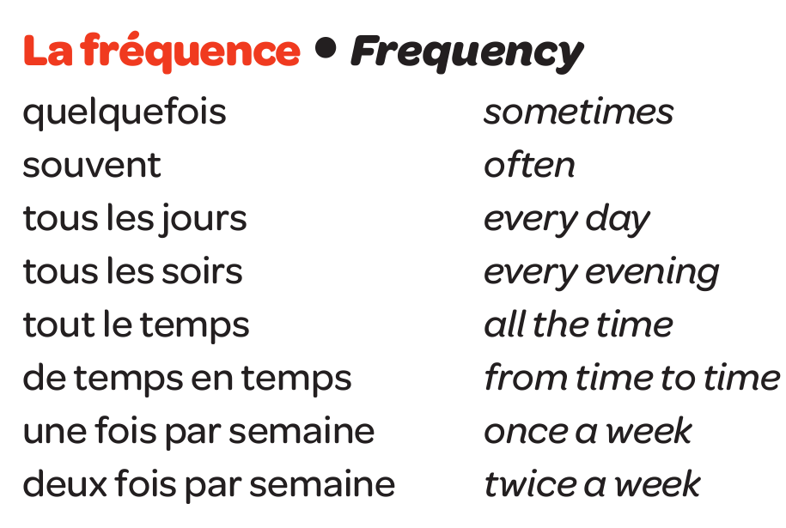
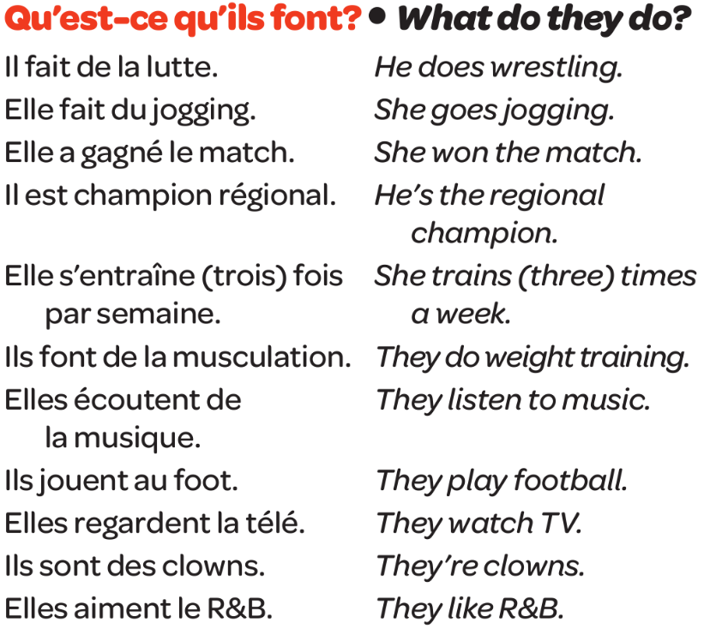
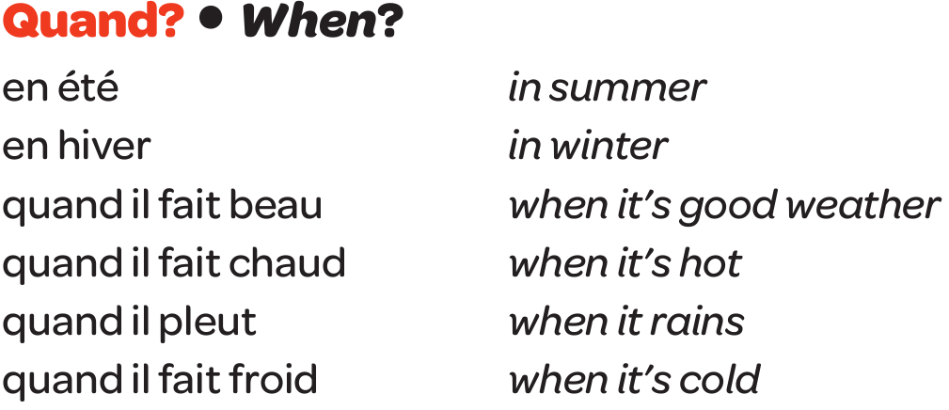
Year 7 - Knowledge Organiser 3 Module 3:Mes passetemps

