Slide 1
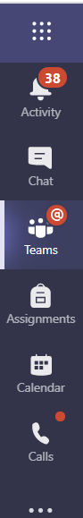
Using the chat feature in MS Teams
Once logged into Microsoft Teams
In the left hand menu click ‘Chat’

Slide 2
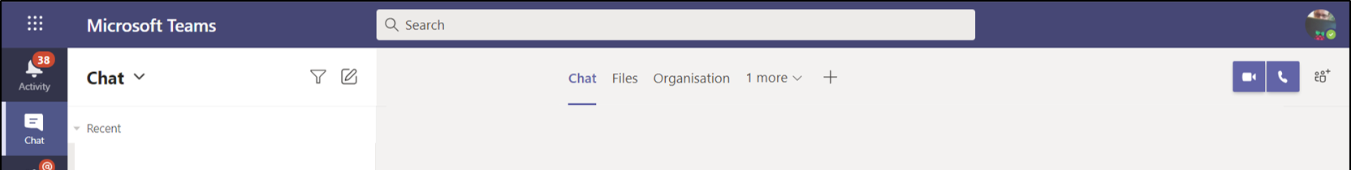
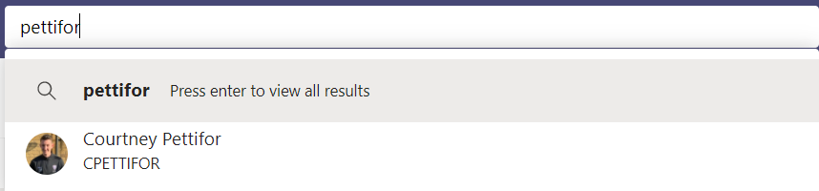
Type the Teachers surname into the search box
Select the Teacher from the list.

Slide 3
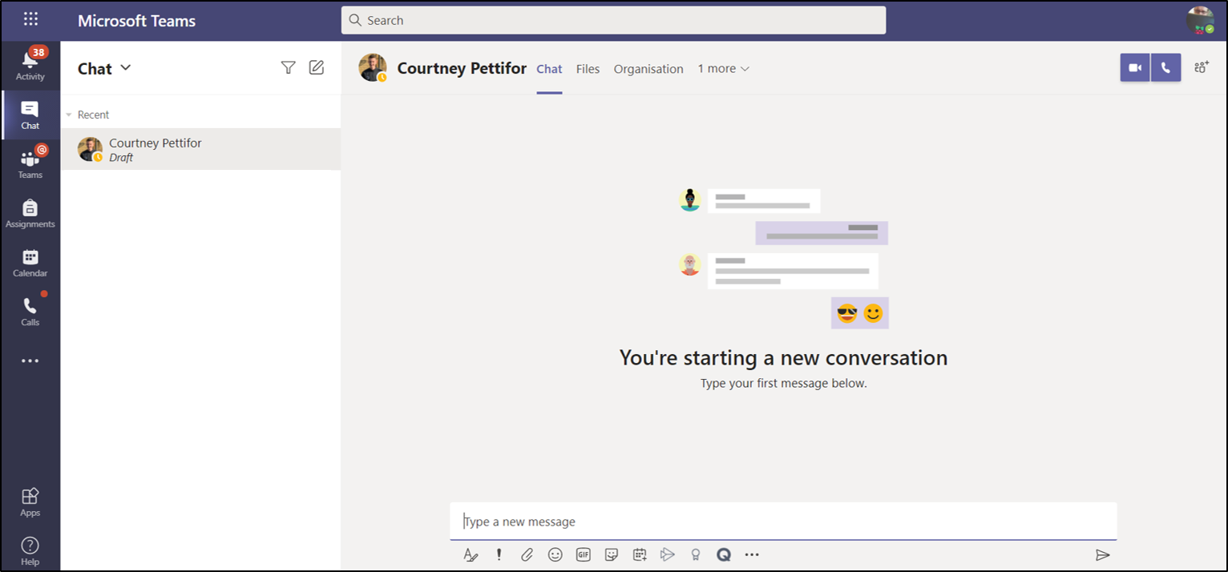
Add your message at the bottom of the screen and click send
Your Teacher will see the message and reply
Your will see the reply in the same window

