Slide 1

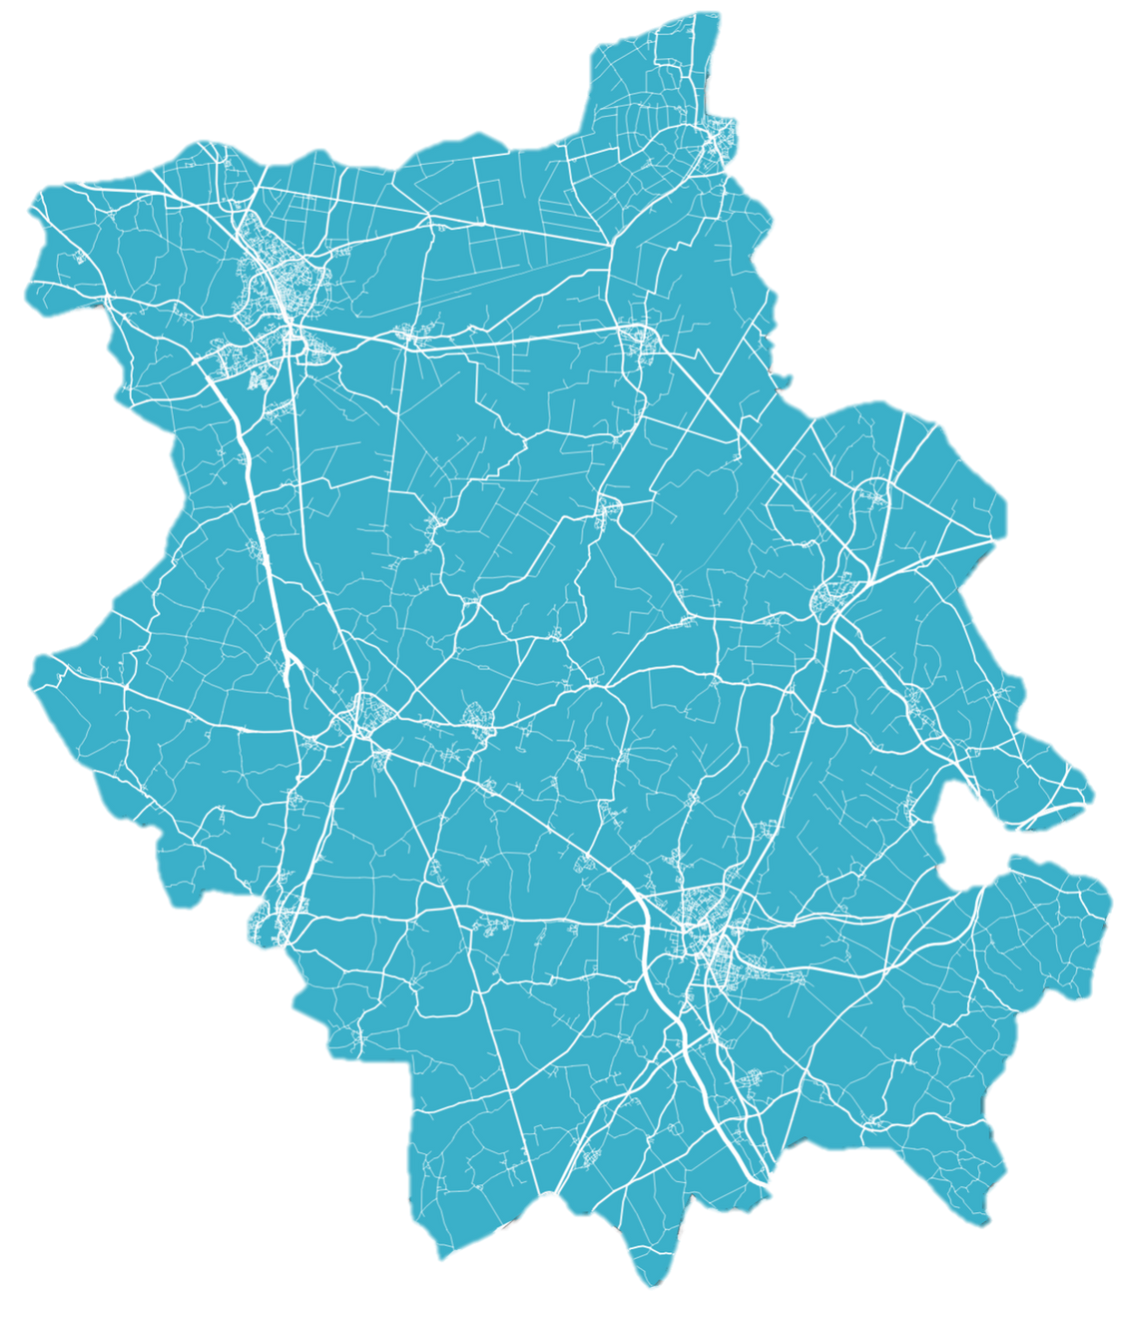
WORK & SKILLS OPPORTUNITIES
IN CAMBRIDGESHIRE AND PETERBOROUGH

Slide 2
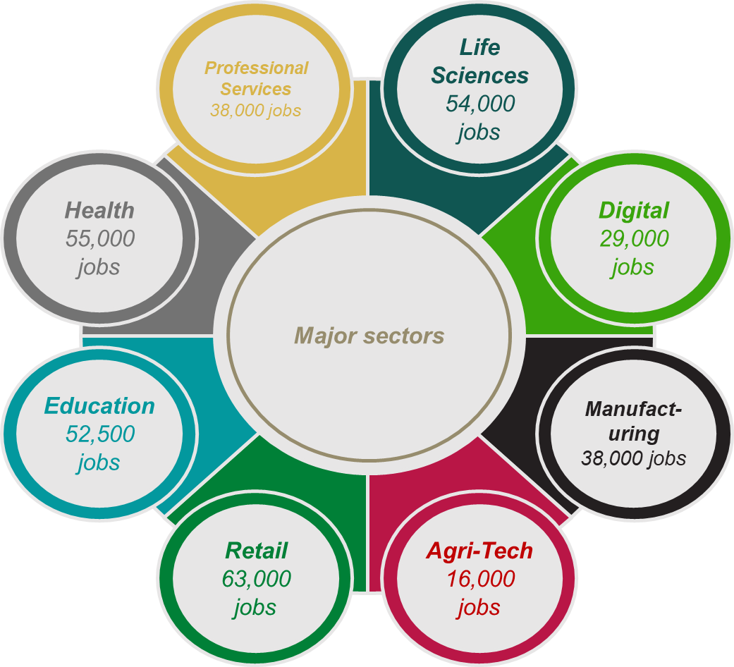
Work & skills today
Cambridgeshire & Peterborough has a huge array of jobs and opportunities on offer. As well as a host of different roles in key sectors including Health, Education and Retail, we also have major opportunities in sectors vital to growing our local economy. These are specialisms within broader sectors, and are: Life Sciences, Digital, Advanced Manufacturing and Agri-Tech.
430,000
44%
Of people have a university level qualification
Number of jobs
£32,000
36,000
Median salary
Businesses

Slide 3

HUBS OF EMPLOYMENT IN CAMBRIDGESHIRE AND PETERBOROUGH
1
Peterborough Advanced Manufacturing Cluster
Close geographical concentration of robotics, metals and machinery businesses
6
  WISBECH
6
Fenland Agriculture
Group of Farming, Agri-tech and Agricultural Manufacturing businesses
  PETERBOROUGH
1
7
  WHITTLESEY
  MARCH
2
Huntingdon Retail Park
Cluster of retail and hospitality businesses
7
Peterborough Logistics Cluster
Area of logistics businesses transporting goods along motorway routes
  RAMSEY
  CHATTERIS
3
Huntingdonshire Manufacturing Cluster
A close geographical concentration of manufacturing businesses in Huntingdonshire
10
  ELY
8
Lancaster Way Business Park
Large industrial and commercial cluster of tech manufacturing companies
2
8
3
  ST IVES
  HUNTINGDON
10
9
4
10
4
Cambourne Business Park
Cluster of Tech and Professional Services offices
5
9
Cambridge Research Park
Cluster of Tech and Life Science research businesses and distributors
  CAMBRIDGE
  ST NEOTS
5
Cambridge City Centre
Educational, Retail and Hospitality hub
10
Enterprise Zones
Including Northstowe Enterprise Zone, Alconbury Weald and Cambridge Compass Enterprise Zone

Slide 4









What local career opportunities are available to you?
LIFE SCIENCES
AGRI-TECH
HEALTH
Life Sciences is the application of biology and technology to health improvement, and is one of the largest sectors in Cambridgeshire, employing 54,000 people
Agri-Tech is the use of technology to make farming more efficient. It employs 16,000 people in Cambridgeshire & Peterborough.
55,000 people are employed across health and social care in Cambridgeshire & Peterborough, including doctors, nurses, care workers and care assistants.
ADVANCED MANUFACTURING
DIGITAL
RETAIL
Advanced Manufacturing is a modern form of Manufacturing using advanced technology, employing 22,000 people.
Digital involves the trade of goods and services using computer networks and technological infrastructure, employing 27,000 people.
Retail employs 63,000 people in Cambridgeshire & Peterborough, with a wide range of possible career paths including cashiers and store managers.
PROFESSIONAL SERVICES
EDUCATION
TRANSPORT
Professional Services involves the provision of specialist services to businesses, including IT, finance and business advice , and employs 58,000 people.
52,500 people are employed within education in Cambridgeshire & Peterborough, including teachers and teaching assistants.
Transport employs 24,500 people in Cambridgeshire & Peterborough, with a wide range of possible career paths, including drivers, pilots and cabin crew.

Slide 5





LIFE SCIENCES
Average Salary:
Number of Jobs:
CAREERS IN
£40,000
24,000
The application of biology and technology to health improvement
Per Year
The Life Sciences industry in Cambridge is unique in its size and influence, and of huge importance to the local economy, anchored by the Cambridge Biomedical Campus.
Skills
Complex analytical skills
Communication
Problem Solving
IT skills
Early Career Opportunities
Essential Qualifications
  Degree in a related science subject for some roles, however increasingly Apprenticeships are an important route into the industry.
  Apprenticeships and practical qualifications such as T Levels are particularly important for technician roles.
  Biomedical Scientist
  Microbiologist
  Industrial Pharmacist
  Research Assistant
  Laboratory Assistant
A Levels or T Levels
In subjects including Maths and the sciences
Degree or Apprenticeship
In Biology, Chemistry, Biosciences or related area
Work experience
In a laboratory or technician role
Sources: ONS, Parliament UK, Prospects, Jobs.ac.uk, Biospace

Slide 6


EMPLOYER PROFILE
working at
ASTRAZENECA
  AstraZeneca is a global pharmaceuticals company, employing over 7,000 people in the UK with a major presence in Cambridge.
  Jobs at AstraZeneca can include working in Life Sciences and research into new medicines, but also in business functions such as IT and Project Management.
  The required skills and qualifications vary depending on the job. Some jobs within AstraZeneca will require degrees, but they also recruit at school leaver level and run apprenticeships.

Slide 7
DIGITAL
Average Salary:
Number of Jobs:
CAREERS IN
£41,000
29,000
The use of technology to trade goods and services, and innovate
Per Year
Digital is a major opportunity sector in the region and is key to the growth of the local economy with many digital businesses growing and offering exciting opportunities.
Skills
IT & technical skills
Critical Thinking
Creativity
Attention to Detail
Early Career Opportunities
Essential Qualifications
  Data Scientist
  Digital Marketing Assistant
  Cyber Intelligence Officer
  User Experience (UX) Designer
  Virtual Assistant
  Customer Service Assistant
  Degree in Maths, Business or Computer Science may be an advantage for some roles.
  However Digital is a sector where Apprenticeships are a major opportunity, including IT, marketing and business analysis.
  Often opportunity for continuous education during employment.
A Levels
In subjects including Maths, IT or Computer Science, or T Levels in Digital
Degree
In IT or Computer Science
or Apprenticeship
in Marketing, Data Science or Business Analysis
Work experience
In a Digital Marketing or Software company
Sources: ONS, National Careers Service, TargetJobs, SmartSheet

Slide 8

EMPLOYER PROFILE
working at
AMAZON
  Amazon is one of the world's largest online retailers and service providers, employing almost 1.5 million people globally.
  Amazon has a large Development Centre located in Cambridge, with an array of opportunities for careers in Digital, working on cutting edge services including Amazon Alexa, Amazon Devices and Amazon Web Services. There is also a large distribution centre in Peterborough, with opportunities in logistics.
  Most of these digital roles will require at least A Levels and possibly a degree or equivalent qualification in Software Development or Computing.

Slide 9



Average Salary:
Number of Jobs:
CAREERS IN
ADVANCED MANUFACTURING
£38,500
22,000
The production of goods using cutting edge technologies and techniques
Per Year
Advanced Manufacturing is key to the growth of the local economy, with major employment sites across Cambridgeshire & Peterborough.
Skills
Creative Thinking
IT skills
Communication
Working as part of a
team
Early Career Opportunities
Essential Qualifications
  For Engineering roles, a Science, Technology, Engineering or Maths (STEM) qualification will be required, either a degree, or T Levels and an Apprenticeship.
  For practical roles in particular there is an emphasis on vocational education.
  Computer-aided Design Technician
  Robotics Engineer
  Wielder
  Production Engineer
  Factory Operative
A Levels
In subjects such as Maths and science
Or T Levels in Engineering & Manufacturing
Degree
In Science, Maths or Engineering
Or Apprenticeship
in Engineering or Manufacturing
Work experience
In a manufacturing, pharmaceutical or engineering company
Sources: ONS, Parliament UK, Indeed, Vector Solutions

Slide 10


EMPLOYER PROFILE
working at
MARSHALL GROUP
  Marshall Group is an advanced manufacturing company based in South Cambridgeshire, specialising in aerospace solutions.
  It is also a major local employer, with over 2,000 staff members working across an array of services including aircraft maintenance, modification and design.
  The required skills and qualifications vary depending on the job, with technical roles requiring a degree level qualification, but many other roles requiring either A Levels or relevant work experience, possibly gained through an apprenticeship.

Slide 11



Average Salary:
Number of Jobs:
CAREERS IN
AGRI-TECH
£28,500
16,000
The use of technology to make farming more efficient
Per Year
Agri-Tech is another major growth sector across the Cambridgeshire & Peterborough area, with exciting opportunities across the region.
Skills
Data skills
Initiative
Time management
Adaptability
Early Career Opportunities
Essential Qualifications
  Agriculturist
  Agricultural Field Technician
  Software Engineer
  Business Advisor
  Farming Assistant
  For Scientific and Engineering roles within Agri-Tech a STEM qualification may be required, which could be a degree, T Levels or an apprenticeship
  Vocational education or apprenticeships are particularly important for more practical roles.
A Levels
In subjects including IT and the sciences,
Or T Levels in agriculture and land management
Degree
In Biology, Engineering or Biosciences
Or Technician Apprenticeship
Work experience
In a laboratory or technician role
Sources: ONS, Investment Monitor, Simply Hired, National Careers Service

Slide 12

EMPLOYER PROFILE
working at
MCCAINS FOOD
  McCains Food is a major global food supplier. It has 52 production facilities across six continents, employing over 21,000 employees across the world.
  McCains has a significant presence in Fenland, with opportunities in agriculture and agri-tech as well as manufacturing and retail distribution.
  The required skills and qualifications vary depending on the job, with some agriculture roles being purely entry level and only requiring GCSEs, whilst other more technical roles will require qualifications including T Levels or A Levels.

Slide 13
Average Salary:
Number of Jobs:
CAREERS IN
RETAIL
£20,500
63,000
The sale of goods and services to the public for consumption
Per Year
Retail is a huge and important sector across the region, and is also changing rapidly, as more customers switch to online and digital shopping, creating exciting new opportunities.
Skills
Working under pressure
Teamwork
Initiative
Customer service
Early Career Opportunities
Essential Qualifications
  Warehouse Operative
  Shelf Stacker
  Cashier
  Store worker
  Management graduate scheme
  Assistant Store Manager
  For entry level roles, GCSEs may be required, although some employers may be flexible, offering on the job training.
  For apprenticeships, GCSEs will be required for entry, with a degree required for management graduate schemes.
GCSEs or initial work experience, entering on the job training
Qualification (such as T Levels), additional on the job training or retail employer apprenticeship
Career progression following apprenticeship, work experience or employer training
Sources: ONS, Gov.uk, Milkround, Prospects

Slide 14


EMPLOYER PROFILE
working at
HOTEL CHOCOLAT
  Hotel Chocolat is a British chocolate manufacturer, selling chocolate and cocoa products, online, in store and in cafés, with over 1,000 employees nationally.
  Hotel Chocolat has a factory outlet in Huntingdonshire, so there are customer facing retail opportunities in the shop and café, but also opportunities in the factory, including in packing, manufacturing and digital.
  The required skills and qualifications vary depending on the job, with retail roles requiring GCSEs, with some more technical roles requiring specific qualifications including A Levels or T Levels, or specific on the job training.

Slide 15



Average Salary:
Number of Jobs:
CAREERS IN
EDUCATION
£26,300
52,500
Teaching and the transfer of knowledge to children and young adults
Per Year
Education is a crucial sector locally and nationally, with opportunities in Cambridgeshire & Peterborough's schools, colleges and world leading universities.
Skills
Patience
Empathy
Creativity
Communication skills
Enthusiasm
Early Career Opportunities
Essential Qualifications
  Trainee Teacher
  Teaching Assistant
  Classroom Support Worker
  Playground Supervisor
  School Receptionist
  To become a Teacher a degree level qualification is required, as well as a teacher training PGCE, whereas Support Workers may require Education and Childcare qualifications such as T Levels.
  To become a Teaching Assistant, GCSEs English and Maths are needed, and a qualification in childcare or nursery work can be an advantage.
A Levels
In the subjects you want to teach
Or T Levels in Education and Childcare
Degree
In the subject you want to teach Or Education or childcare qualification
PGCE, or work experience as a Teaching Assistant
Sources: ONS, Gov.uk, Milkround, Prospects, Get Into Teaching

Slide 16


EMPLOYER PROFILE
working at
UNIVERSITY OF CAMBRIDGE
  The University of Cambridge is one of the most prestigious universities in the UK, with over 20,000 students.
  However it is also a major local employer, with over 12,000 staff members working across an array of services. The university has career opportunities available in academia, but also within Digital and IT, student services and support, project management and administrative functions.
  The required skills and qualifications vary depending on the job, with academic roles requiring a degree, but administrative and support roles requiring GCSEs and either A Levels or an equivalent qualification.

Slide 17



Average Salary:
Number of Jobs:
CAREERS IN
HEALTH
£22,800
55,000
The provision of health care and medical care to individuals and the community
Per Year
Health care is vital for the health and wellbeing of people within Cambridgeshire & Peterborough, with opportunities in hospitals and care settings across the region.
Skills
Scientific knowledge
Empathy
Working under pressure
Methodological thinking
Early Career Opportunities
Essential Qualifications
  Nurse
  Junior Doctor
  Trainee Vet
  Care Worker
  Care Giver
  Medical Assistant
  Ambulance Care Assistant
  To become a doctor, nurse or vet a medicine or nursing degree, including on the job training, is required.
  However vocational options such as T Levels are also available for careers including care workers, emergency care assistants or ambulance care assistants.
A Levels
In subjects including Maths and the sciences
Or T Level in Health or Healthcare Science
Degree
In Medicine, Veterinary Medicine or Nursing
Or HTQ in Health and Science and on the job training
Professional training and work experience in chosen field
Sources: ONS, Gov.uk, Milkround, Prospects

Slide 18

EMPLOYER PROFILE
working at
NHS
  The National Health Service (NHS) is the national provider of health care across the UK, employing over 700,000 people across the country.
  Jobs within the NHS include doctors, nurses, midwives and other healthcare professionals, including community care, but there are also opportunities available within digital, project management, administration and support services. Major hospitals within the area include Addenbrookes, Papworth and Rosie on the Cambridge Biomedical Campus, as well as Peterborough City Hospital, specialising in Radiotherapy and Oncology, and Hinchingbrooke Hospital, with specialties including vascular services and children's health services.
  The required skills and qualifications will vary, with doctors and nurses requiring a degree in Medicine or Nursing, and care workers requiring specific qualifications. A degree may be helpful for digital or support roles, but there are roles for which GCSEs and A Levels are sufficient, and the NHS offers apprenticeships and training.

Slide 19



Average Salary:
Number of Jobs:
CAREERS IN
PROFESSIONAL SERVICES
£32,700
58,000
The provision of specialist services to businesses, including IT, finance and business advice
Per Year
Professional services spans many sectors and industries, and whilst there are clusters in Cambridge, there are opportunities available across the region.
Skills
Analytical skills
Teamwork
Problem solving
Methodological thinking
Early Career Opportunities
Essential Qualifications
  Trainee Accountant
  Management Consultant
  Trainee Lawyer
  Architect
  Receptionist
  Admin assistant
  For some roles, particularly within law, a relevant degree will be required.
  For industries such as Accounting or Business Admin, Apprenticeships are offered, which may require A Levels, although T Levels in areas such as Accounting are becoming increasingly popular.
A Levels or T Levels
In subjects relevant to chosen pathway, such as Maths, Law or Accounting
Degree
In relevant subject, or Apprenticeship in chosen field
Work experience
In a business or organisation of interest
Sources: ONS, Gov.uk, Milkround, Prospects

Slide 20

EMPLOYER PROFILE
working at
CAMBRIDGESHIRE COUNTY COUNCIL
  Cambridgeshire County Council is responsible for public services across Cambridgeshire, and its vision is to make Cambridgeshire a great place to call home.
  There are a wide range of career opportunities at the County Council, working within areas including Education, Transport and Social Care, but also within functions including IT and Human Resources.
  The required skills and qualifications vary depending on the job. Some jobs, such as within social care, will require specific qualifications, but the County Council also recruits at school leaver level and provides on the job training.

Slide 21

Average Salary:
Number of Jobs:
CAREERS IN
TRANSPORT
£30,000
24,500
Taking and carrying people, goods and services from one location to another
Per Year
Transport is another hugely important part of our daily lives, and the sector is a key part of the local economy, with opportunities across the region.
Skills
Quick thinking
Communication skills
Time management
Adaptability
Early Career Opportunities
Essential Qualifications
  Transport Planner
  Pilot Cadet Programme
  Cabin Crew
  Train Station worker
  Bus driver
  Train driver
  For most roles GCSEs will be required, with some more technical roles requiring A Levels, T Levels or specific qualifications.
  To become a pilot, you need to undertake a specific pilot training course.
  A driving licence is required for any driving-based roles.
GCSEs including Maths & English, plus A Levels or T Levels in relevant subjects
Degree, Apprenticeship or Training Programme in Transport area of interest, including Planning or Logistics
Work experience
and on the job training
Sources: ONS, Gov.uk, Milkround, Prospects

Slide 22


EMPLOYER PROFILE
working at
WELCH'S TRANSPORT LTD
  Welch's Transport Ltd is a leading haulage company, with headquarters in Duxford. It specialises in transportation and storage solutions including general haulage, pallet delivery and the storage and distribution of dangerous goods and abnormal loads.
  There are a range of career opportunities available, including drivers, warehouse operatives, administration and HGV Drivers Apprenticeships.
  The required skills and qualifications vary depending on the job. Driving jobs will require the appropriate vehicle licences, and apprenticeships will require GCSEs, with specific qualifications required for more technical roles.

Slide 23


Jobs in Cambridge
Top Sectors in cambridge
Number of jobs
69,600
64%
40,000
30,000
Of people have a university level qualification
Jobs
20,000
10,000
0
£30,500
5,000
Food
Health
Retail
Education
Professional
Median Salary
Businesses
MAJOR EMPLOYERS
EDUCATION
Including: teaching, teaching assistants
HEALTH
Including: nursing, social care, medical practitioners
is a major global pharmaceutical company with a huge presence in Cambridge, with opportunities in life sciences, digital and research.
PROFESSIONAL SERVICES
ASTRAZENECA
Including: engineering, law, science, technology
UNIVERSITY OF CAMBRIDGE
is one of the largest employers in Cambridge, with opportunities in professional services, digital, academia and student services including mental health support.
RETAIL
Including: sales, merchandising, logistics, customer service
FOOD
Including: food manufacturing, distribution, farming

Slide 24


Jobs in peterborough
Top Sectors in PETERBOROUGH
Number of jobs
98,000
36%
25,000
20,000
Of people have a university level qualification
15,000
Jobs
10,000
5,000
0
£25,600
8,000
Retail
Health
Admin
Transport
Manufacturing
Median Salary
Businesses
MAJOR EMPLOYERS
RETAIL
Including: sales, merchandising, logistics, customer service
HEALTH
Including: nursing, social care, medical practitioners
Is one of the world's largest online retailers and service providers, employing almost 1.5 million people globally, with a major distribution centre in Peterborough.
Including: secretary, receptionist, administration support
AMAZON
ADMIN
TRANSPORT
Including: haulage, distribution, delivery driver
LIDL
Is a major European retailer, with a £70million warehouse in Peterborough, employing over 400 people.
MANUFACTURING
Including: engineering, distribution, farming

Slide 25
Jobs in south Cambridgeshire
Top Sectors in SOUTH cambridgeSHIRE
Number of jobs
80,000
63%
20,000
15,000
Of people have a university level qualification
Jobs
10,000
5,000
0
£33,400
8,400
Retail
Digital
Health
Professional
Manufacturing
Median Salary
Businesses
MAJOR EMPLOYERS
PROFESSIONAL SERVICES
Including: engineering, law, science, technology
AMINO COMMUNICATIONS
is a global technology solutions provider, with its UK headquarters in South Cambridge. There are career opportunities within Digital and Manufacturing.
MANUFACTURING
Including: engineering, distribution, farming
RETAIL
Including: sales, merchandising, logistics, customer service
MARSHALL GROUP
operates within advanced manufacturing, specialising in aerospace solutions, and is based in South Cambridgeshire.
DIGITAL
Including: data science, IT, digital marketing
HEALTH
Including: nursing, social care, medical practitioners

Slide 26
Jobs in east Cambridgeshire
Top Sectors in east cambridgeshire
Number of jobs
46,000
35%
5,000
4,000
Of people have a university level qualification
3,000
Jobs
2,000
1,000
0
£25,000
4,000
Admin
Retail
Education
Manufacturing
Transport
Median Salary
Businesses
MAJOR EMPLOYERS
RETAIL
Including: sales, merchandising, logistics, customer service
ADMIN
Including: secretary, receptionist, administration support
ELYSIUM HEALTHCARE
is a health and social care provider, specialising in neurological and children's services
MANUFACTURING
Including: engineering, distribution, farming
is a global optical technologies company with a base in Ely, specialising in the design and manufacture of innovative photonics products for manufacturing and research.
EDUCATION
Including: teaching, teaching assistants
THORLABS
Including: haulage, distribution, delivery driver
TRANSPORT

Slide 27
Jobs in fenland
Top Sectors in fenland
Number of jobs
48,500
17%
6,000
Of people have a university level qualification
4,000
Jobs
2,000
0
£20,600
3,700
Admin
Retail
Health
Manufacturing
Transport
Median Salary
Businesses
MAJOR EMPLOYERS
MANUFACTURING
Including: engineering, distribution, farming
RETAIL
Including: sales, merchandising, logistics, customer service
Is one of Europe’s largest food and drink groups. They source and manufacture products, and supply food and drink to suppliers across Europe.
PRINCES GROUP
ADMIN
Including: secretary, receptionist, administration support
Is a major global food supplier with a significant presence in Fenland, with opportunities in agri-tech, manufacturing and retail distribution.
HEALTH
Including: nursing, social care, medical practitioners
MCCAINS FOOD
TRANSPORT
Including: haulage, distribution, delivery driver

Slide 28
Jobs in huntingdonshire
Top Sectors in huntingdonshire
Number of jobs
86,300
38%
12,500
10,000
Of people have a university level qualification
7,500
Jobs
5,000
2,500
0
£27,800
7,900
Retail
Health
Admin
Manufacturing
Professional
Median Salary
Businesses
MAJOR EMPLOYERS
RETAIL
Including: sales, merchandising, logistics, customer service
MANUFACTURING
Including: engineering, distribution, farming
HINCHINGBROOKE HOSPITAL
A 304 bed hospital providing surgeries, ear nose and throat, vascular services and children's health services
HEALTH
Including: nursing, social care, medical practitioners
ADMIN
Including: secretary, receptionist, administration support
HOTEL CHOCOLAT
is a British chocolate manufacturer, selling chocolate and cocoa products, online, in store and in cafés, with a factory outlet in Huntingdon.
PROFESSIONAL SERVICES
Including: engineering, law, science, technology

Slide 29
FURTHER STUDY
Pathways from school into employment
university
apprenticeships
ON THE JOB TRAINING
University degrees usually last a minimum of 3 years and involve studying through a mix of lectures and tutorials, and completing coursework and exams, and can provide pathways into many different careers.
Apprenticeships provide a route into industry, available across a wide range of industries. Apprenticeships allow you to 'work whilst you learn' and you will usually spend a set amount of time studying for a professional qualification, or possibly a degree, whilst you work for a particular company.
On the job training is training or education that takes place whilst in a job. This might be informal learning from a manager or mentor, but may also be formal learning for a professional qualification that is needed to progress in the job.
TECHNICAL EDUCATION
WORK EXPERIENCE
ROUTES TO FURTHER STUDY
Technical education is a career focused option, with T Levels a technical alternative to A Levels, and Higher Technical Qualifications (HTQ) an alternative to degree, developed with businesses, with specific skill requirements in mind.
Work experience is where you gain experience of what it is like to work within a particular job or company. It is usually short and runs for one or two weeks, and is usually unpaid. Work experience is often organised by schools and usually takes place whilst you are still in education.
GCSEs remain a compulsory qualification in the UK, and moving into some forms of further study will require five passes at GCSE, including Maths and English. Resitting these qualifications is an option in order to progress to further study or work. Alternatively, Level 2 BTECs, NVQs, and Functional Skills are also a pathway into further education.

Slide 30
FURTHER STUDY
Local education providers in Cambridgeshire & Peterborough
COLLEGES
HIGHER EDUCATION
ADULT LEARNING
Local colleges include:
  Inspire Education Group – Peterborough College and Stamford College
  Cambridge Regional College
  College of West Anglia
  Bedford College
  West Suffolk College
  North Hertfordshire College
  North Cambridgeshire Training Centre
In addition, a large proportion of our secondary schools offer Sixth Form colleges, where students can study A Levels, T Levels, BTECs and wider curriculum offers.
Local Higher Education providers include:
  University of Cambridge
  Anglia Ruskin University Cambridge
  ARU Peterborough
  University Centre Peterborough
  Cambridge Regional College
  Inspire Education Group - Peterborough
Local training providers include:
  The Skills Network
  Purple Beard
  Capita Public Service
  Construction Skills People Ltd
  Duplex Business Services
  Imeta Training Ltd
  Retrofit Academy
  Steadfast Training
  Back to Work
  NACRO
  SERCO
  Ixion
  New Meaning Foundation
  Cambridgeshire Skills

Slide 31
LOCAL CAREERS SERVICES
local careers services available include
  Career Focus Cambridge
  University of Cambridge Careers Service
  Cambridgeshire Skills
  Cambridgeshire & Peterborough Careers Hub
  National Careers Service
  JobCentrePlus
  Form The Future
  Peterborough Online Careers Service

