Slide 1

WVC reopening
Student information and instructions

Slide 2
Why are we reopening?
The government have deemed that the risk of infection is such that it is safe for a small number of students to return to school.
Some students have already returned in primary schools, and now year 10s have been invited to return to school.
We have put in place a number of changes to how the college will operate that are designed to make you and your teachers as safe as possible.
It is extremely important that you now read everything in this presentation so you are ready to return safely.

Slide 3
What do I need for school?
No uniform is needed. Wear something that is appropriate for school. No extremes of dress, piercings etc. will be allowed more detail
Water in a plastic or metal bottle - ideally non disposable
Normal phone rules remain
Food for the day – there will be no food available in the college during the day – all rubbish should be taken home
All equipment pens, pencil ruler etc. THERE WILL BE NO EQUIPMENT TO BORROW
Exercise books and paper - THERE WILL BE NONE AVAILABLE TO BORROW
One bag that will be stored under your desk
Use of a face mask or gloves is optional

Slide 4
Getting to school
Walking
Maintain social distancing of two metres, DO NOT walk in groups
When you arrive in school go straight to your allocated area
Car
Disembark straight away and maintain social distancing of two metres, DO NOT join a group
When you arrive in school go straight to your allocated area
Bus
When queueing for the bus keep two metres apart
The instructions on what to do on board have been provided via Greys coaches
Keep to your designated seat
Disembark straight away and maintain social distancing of two metres, DO NOT join a group
When you arrive in school go straight to your allocated area

Slide 5
What happens when you get to school?
Your classes
You will have been allocated the classroom and area you will be based in all day
Go straight to your allocated class/area
Your teachers will come to your class
You will be in different classes to normal and may have different teachers
Route
Follow the green arrows as per the map around the side of the school towards English
Do not access any other part of the school without permission
When you arrive there
Use the gel provided to disinfect your hands before you go into the building own gel may be used
Proceed to your designated classroom and take your allocated seat
Bags should be placed under the seat
Have all equipment out ready for the lesson

Slide 6
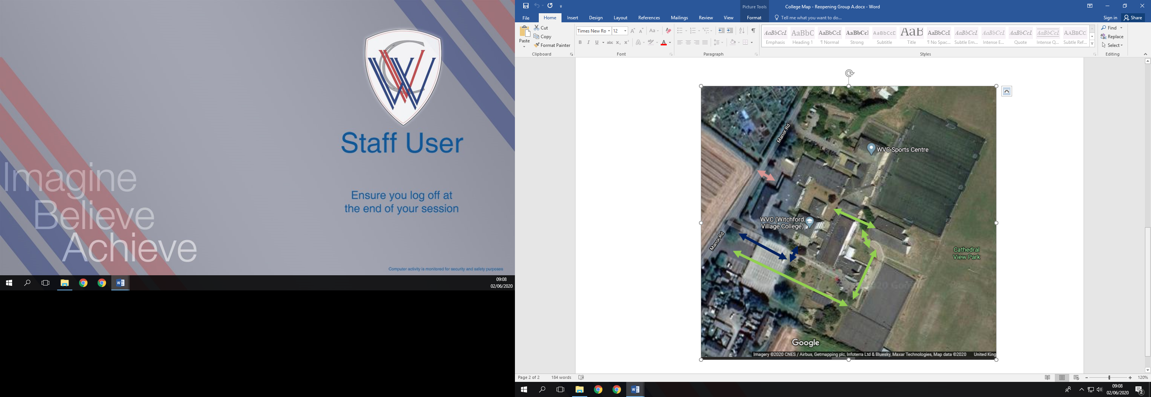
Year 10 students route
Key workers students route

Slide 7
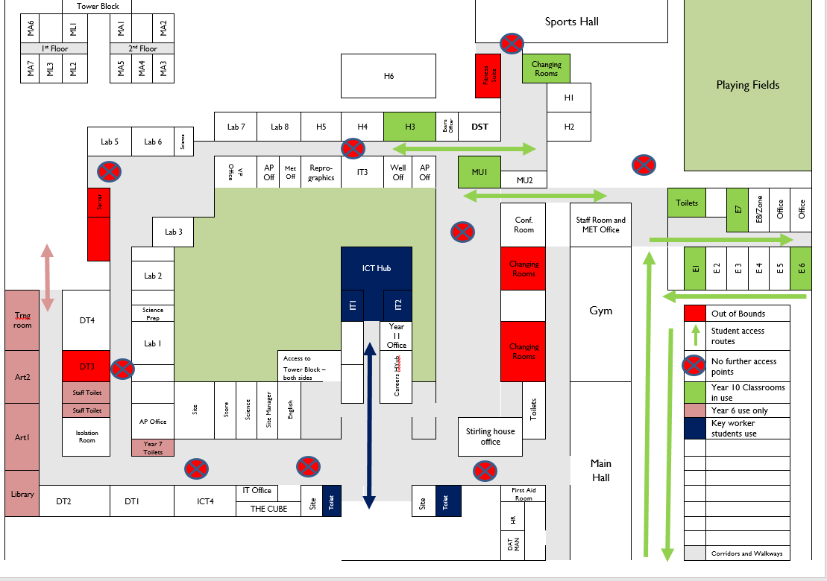
All students will be allocated to specific rooms:
Year 10 Rooms and spaces
Key worker rooms and spaces
Year 6 Rooms and Spaces
All groups have their own toilets allocated to them and their own outside space if required. In the case of poor weather, breaks will be taken inside allocated rooms.

Slide 10
Expectations in school?
Work
You will be expected to work
You will have English, Maths and Science every day
Your final period will be a tutor period where you will have input from your other subjects
Toilets
Chose appropriate times for toilet breaks, so we can maintain social distancing, ask permission from your teacher first
Full hand washing protocols must be followed
Only the toilets allocated should be used
Breaks
You will be allowed to go outside during breaks, but you must stay in that area
Maintain full social distancing at all times
All rubbish should be taken home NOT left in bins in school
If the weather is wet you will remain in your classroom

Slide 11
Expectations in school
Behaviour
High standards of behaviour will as normal be expected at all times.
Listen, learn, be respectful, work hard!
IF YOU DELIBERATELY BREAK SOCIAL DISTANCING RULES BOTH IN SCHOOL AND TRAVELLING FROM AND TO SCHOOL, OR PLACE OTHERS AT RISK YOU WILL BE REMOVED FROM CLASS AND IMMEDIATELY SENT HOME
Do not go anywhere else in school unless specifically directed to by a member of staff
Illness
If you have any flu like symptoms you should not attend school, but phone into school and let us know
If you start feeling ill whilst in school, you must immediately inform a member of staff

Slide 12
Leaving school
Walking
Maintain social distancing of two metres, DO NOT walk in groups
When you leave school go straight home
Car
Embark straight away
If you are waiting maintain social distancing of two metres, DO NOT join a group
Bus
When queueing for the bus keep two metres apart
The instructions on what to do on board have been provided via Greys coaches
Keep to your designated seat
Disembark straight away and maintain social distancing of two metres, DO NOT join a group
When you leave school go straight home

Slide 13
Expectations at home
Work!
All subjects are crucial
You are expected to be working on your option subjects at home!
You will still be having exams on them next year so don’t fall behind!

