Slide 1
Witchford Village College
Transition Workbook
2020
imagine, believe, achieve

Slide 2
Moving from primary to secondary school is an exciting, but sometimes scary time! A new building, new rules, new teachers, new routines and new friends are just some of the changes you will experience. We hope that filling this in for your form tutor will get us off to a good start.
It can be digital or printed. You will be asked to bring it with you when we start school. If you get stuck or can’t do any of it, please don’t worry, you will not be in any trouble.

Slide 3
All About Me
Draw a self portrait here. (or add a photo of you doing something you love)
Name:
Birthday:
My primary school:
Eye colour:
Hair colour:
Height:
Siblings:
Pets:
Three words that describe me:
Favourite colour
Favourite animal
If I could have a superpower it would be….
Favourite school subject
Best place I’ve ever been to…
Dream country to visit…
If I could travel back in time, I’d go to…
My dream job is…

Slide 4
Our Expectations
So that we can all work together and enjoy each other’ s company we do ask that you follow a few simple guidelines.
The College expects all students to:
Move about the school with awareness for others
Keep the classrooms, corridors and outside areas clean
Treat everybody with respect
Respond appropriately to all reasonable requests
Be punctual and bring the correct equipment
Not have mobile phones on the site during the school day unless special permission has been given to your parents/guardians. If so the phone must be handed in on arrival to school and collected after school at Student Services
The College Code of Conduct extends to the journey to and from school. Students:
Must behave sensibly
Should not eat or drink on the bus
Should wear their uniform
Must be seated at all times except when boarding and leaving the bus
Must not interfere with another students property
Should carry their bus pass at all times. Should a student lose their bus pass, they must make sure they go to Student Services at break or lunch-time
Thank you!

Slide 5
My Journey So Far
Life is a journey! Think back through primary school and write down your favourite memories or events that have shaped you to become the amazing person you are!

Slide 6
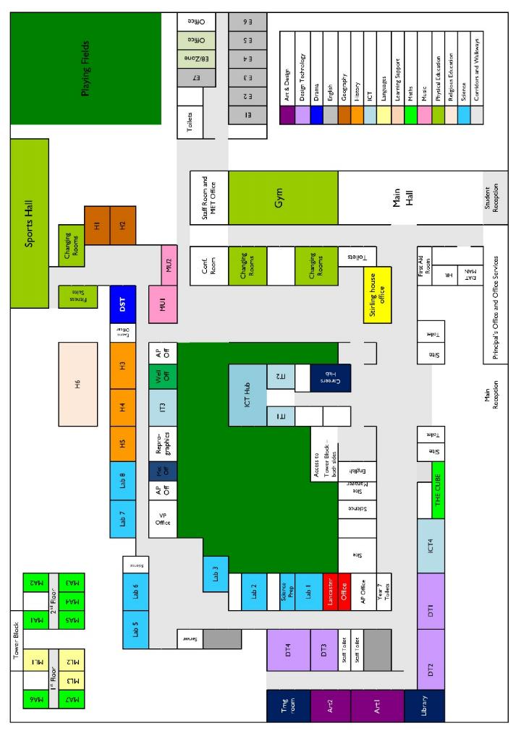

Slide 7
How well do you know the school?
We have sent a video home. As you watch it can you find where we are on the map? Give it ago. Can you draw the route we took around school in the video.

Slide 8
My New Secondary School
Can you use the school website to try and find some of this information: www.witchfordvc.co.uk
Full Name of the School
School Address
School Telephone Number
Name of the Head Teacher
School Starts at
School Finishes at
I will get to school by | (transport type)
How long will it take you to get to school?
What time will you have to leave home?
Add 10 words below to describe your new school
1 |  | 6
2 |  | 7
3 |  | 8
4 |  | 9
5 |  | 10

Slide 9
Moving to Your New School
List 4 things you are most excited about moving to WVC (Witchford Village College)
List 4 things you are a little worried/nervous about
List 4 things you would like to know about WVC
3.
4.
List 4 things that will help you when moving to WVC
List 4 differences between your primary school and WVC
(you may want to show this to a parent/career so you can ask the school if your parent does not know)

Slide 10
Subjects at Your New School
Find the subjects below in the Word search – they are vertical, horizontal and diagonal!
D | N | A | T | R | K | R | S | H | S | I | L | G | N | E | Y | J
M | T | A | G | O | A | A | W | F | A | B | K | D | R | Q | C | A
C | O | M | P | U | T | I | N | G | K | Y | L | E | F | A | Y | R
D | E | O | R | S | K | E | A | R | F | L | D | S | L | E | R | T
T | P | S | P | O | E | J | A | E | Y | F | T | I | L | S | S | T
N | Y | T | M | A | T | H | S | Y | U | J | K | G | T | H | P | E
W | L | D | U | G | P | E | D | R | A | M | A | N | H | O | A | I
B | B | E | S | D | K | S | S | O | G | H | R | T | A | E | N | N
W | M | C | I | H | D | S | U | T | H | J | G | E | J | R | I | E
C | E | A | C | G | J | D | P | S | U | G | G | C | F | O | S | B
V | S | T | U | S | U | I | W | I | I | Y | E | H | Y | A | H | D
T | S | E | C | X | P | H | L | H | G | W | R | F | L | J | K | E
B | A | X | G | C | S | D | P | P | H | J | Q | R | E | C | N | L
B | W | G | E | O | G | R | A | P | H | Y | E | E | R | E | Y | L
T | U | E | H | I | V | S | D | E | O | Q | F | N | I | O | A | W
Q | R | T | U | T | O | R | T | I | M | E | R | C | F | F | F | L
Z | W | A | I | H | S | K | J | H | P | T | S | H | P | O | P | A
Maths
English
Science
Geography
History
Art
Music
PE
Drama
Computing
Spanish
Assembly
Tutor Time
French
Design Tech

Slide 11
Equipment
At secondary school, you will be moving around to different classrooms for different lessons. You could be in 5 classrooms in one day. This means that you need to bring all the equipment you will require with you for the day. You can keep larger items such as your PE kit in your locker, however you can only go to your locker before school, at break and lunchtime and at the end of the day. Below are some items you will need to bring – can you identify them and add anything else?

Slide 12
Looking Smart at Secondary School
One of the different things about moving to secondary school is the change in what you will wear. At WVC, we pride ourselves in looking smart and professional at all times. Use the school website or the information booklet to draw and label the school uniform you will wear onto the Lego figure.
Why is wearing the correct school uniform important?
………………………………………………………………………………………………………………………………………………………………………………………………………………………………………………………………………………………………………………………………………………………………………………………………………………………………………………………………………………………………………………………………………………………………

Slide 13
Getting to Secondary School
Getting to WVC safely is just as important as being there. In the box below, draw the route you are going to take to school (whether that’s walking, cycling, driving or by bus). Identify spots where there could be hazards (e.g. busy roads) and explain how you will manage this safely!

Slide 14
My Goals for Secondary School
When you go to Secondary School, you will learn a huge number of new skills, and improve skills you have practiced in Primary School. In the goal below, use the list to write in 10 new skills or things you’d like to build on in your years at Secondary School.
Be in a school play or production | Speak another language | Represent your school in a national competition
Learn to play a musical instrument | Volunteer in the local community | Travel to another country
Play for a school team | Learn how to survive in the wild | Take care of the school garden
Learn how to manage money | Taste food from another country | Walk the school dog
Cook a new meal from scratch | Read new books | Take part in a fancy dress day
Create a piece of art | Raise money for charity | Become Head Boy or Girl
Learn how to read a map | Join an after school club | Learn to dance
Use computers to create your own website | Learn First Aid | Improve your singing
Make new friends from other schools | Work as part of a team | Try camping

Slide 15
Beyond Secondary School
After secondary school, you can move onto college or an apprenticeship and then to University or into a job! It’s normal not to know what you want to do yet but this is a chance for you to have a think about your dream jobs!
Icons to represent that job:
Job:
Key Skills:
Subjects to Study:
Icons to represent that job:
Job:
Key Skills:
Subjects to Study:
Icons to represent that job:
Job:
Key Skills:
Subjects to Study:

Slide 16
Your career is your pathway through life – a combination of living, learning and earning. During your time at primary school, you may have done activities that helped you to learn about the world of work and to imagine your future career. Now that you’re moving up to your secondary school, you will build on what you already know and begin to identify your own special skill set and understand your strengths and areas for improvement to equip you for the future. Below, you can reflect on your achievements and how these can be used to produce evidence of skills and experiences. This exercise will help you recognise the value of a variety of achievements both in and out of school.
My Achievements by Age 11
Achievements in my Primary School | Evidence I could provide
Achievements outside of school | Evidence I could provide

Slide 17
All areas of life require skills. Some you can learn quickly, and others may take years of experience to get right. Some will be useful for jobs and some for other areas of life. Look at the list of skills below and use the extra space if you can think of any more. Tick if you think you already have this skill. Think about the skills that you could improve on and how you can achieve this.
Skills for life
Skill | Example | Tick
Caring for people
Working in a team
Communicating well
Solving problems
Responding to emergencies
Working with money
Playing a sport
Drawing and painting
Working on your own
Using your imagination
Being good with your hands (practical)
Using maths
Learning from mistakes
Using a computer
Speaking another language
Dealing with difficult situations

Slide 18
… and finally, a message from the Transition Team.
We are looking forward to meeting you all and getting to know you. We hope that you are excited about starting your WVC journey and please know that we are here to help you! If you have any questions, please do not hesitate to contact us. Our details are on the college website.
Stay safe and well and we will see you soon!
Best wishes,
Mr Cook
imagine, believe, achieve

